Slide 1

San Joaquin County GSA No. 1 – Eastern San Joaquin Subbasin Advisory Water Commission Briefing May 20, 2026 Proposed Regulatory Fee for SGMA Compliance (Proposition 26)

Slide 2
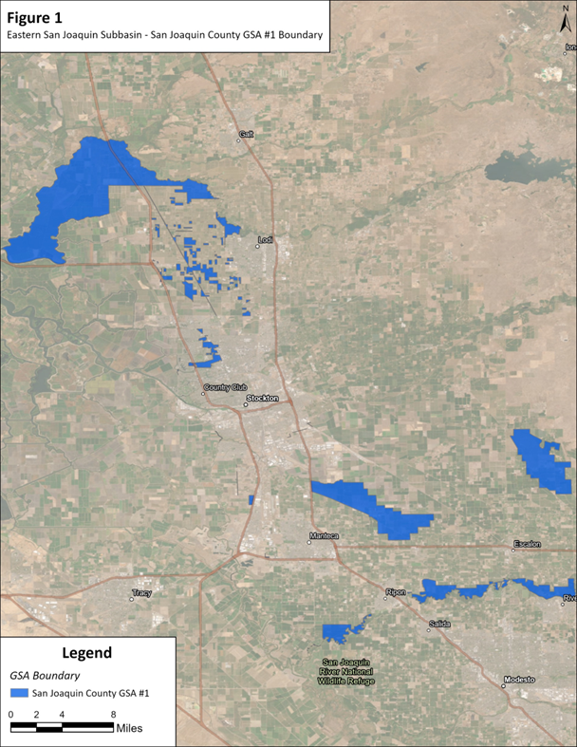
Eastern San Joaquin Subbasin
County GSA No. 1
Eastern San Joaquin Groundwater Authority (ESJGWA)
Joint Powers Authority created in 2017
16 Groundwater Sustainability Agencies (GSAs)
Develops and implements a single basin-wide Groundwater Sustainability Plan (GSP)
Supports Sustainable Groundwater Management Act (SGMA) compliance
Ongoing funding (monitoring, modeling, reporting, administration)
County GSA ESJ No. 1 (46,000 acres) participates and pays proportional share of compliance costs (dues)

Slide 3
Eastern San Joaquin Subbasin
County GSA No. 1 Funding Approach
GSA ESJ No. 1 share of compliance costs (ESJGWA dues) historically funded by Zone 2
Zone 2 is a property-related fee paid by all SJC property owners to support county’s Strategic Plan to Meet Water Needs, adopted in 2015
Proposed regulatory fee would align costs with beneficiaries/groundwater users within County GSA ESJ No. 1

Slide 4
County GSA ESJ No. 1
Proposed Funding Solution
Adopt regulatory fee for SGMA Compliance within County GSA ESJ No. 1 boundary
Fund SGMA regulatory compliance cost (ESJGWA dues)
Repay prior Zone 2 contributions
Cover costs to administer and adopt regulatory fee
Applies to ~800 properties
Collected annually on property tax roll/direct billing to special districts
Water Code §10730 et seq. and California Constitution Article XIII C (Proposition 26)
Notes:
Fee must qualify as regulatory fee (not a tax)
Must not exceed reasonable cost of providing service
Must have nexus between cost and benefit/burden
Authorized under Water Code §10730(a) for groundwater sustainability programs

Slide 5
Proposed Regulatory Fee
Allowable Expenditures and Limitations
 | Administration (governance, legal, finance, coordination)
 | GSP amendments/updates, 5-year periodic evaluations, & annual reports
 | Groundwater modeling and water budgets
 | Monitoring networks and data systems
 | Coordination with DWR and State Water Board
 | Public outreach and stakeholder engagement
 | Capital or infrastructure projects

Slide 6
County GSA ESJ No. 1
Proposed Fee Budget Overview (FY 26/27)
Total fee budget: $129,400
FY 25/26 ESJGWA dues: $42,800
Administrative costs including consultant costs: $46,600
Proposed Zone 2 repayment (Year 1 of 5): $40,000
Total Zone 2 repayment amount: $199,894
Fee calculation will be updated annually based on ESJGWA dues and related consultant costs to administer and collect the fee
Consultant costs will be substantially less in future years

Slide 7
County GSA ESJ No. 1
Proposed Fee Structure Overview
Three components of fee – consistent with ESJGWA dues calculation:
Acreage component (base cost recovery)
Pumping component (60% weighting)
Population component (40% weighting)
Proportionally allocates costs to property owners based on groundwater demand drivers

Slide 8
County GSA ESJ No. 1
Acreage Component
Allocates $10,000 minimum ESJGWA dues across all acres
Uniform cost per acre regardless of land use
FY 26/27 Rate: $0.22 per acre

Slide 9
County GSA ESJ No. 1
Pumping Component
Represents groundwater demand (60% of remaining budget)
Land use–based pumping demand factors (acre-feet per year per acre)
Demand factors align with North San Joaquin Water Conservation District Assessment Engineer’s Report
Examples:
Orchard: ~2.8 afy/acre
Row crops: ~2.2 afy/acre
Rural Residential ≥5 acres: ~2.5 afy/acre
FY 26/27 Pumping Rate: $0.81 per acre-foot

Slide 10
County GSA ESJ No. 1
Population Component
Represents population-related demand (40% of remaining budget)
Residential: persons per housing unit (PPHU) based on latest US Census Data for San Joaquin County
Non-residential: employees per 1,000 sq. ft.
Examples:
Residential: ~3.3 persons/unit
Commercial: ~2.2 employees/1000 sq. ft.
FY 26/27 Rate: $7.07 per person equivalent

Slide 11
County GSA ESJ No. 1
Special Handling for CSAs and MDs
Parcels serviced by County Service Areas (CSAs) and Maintenance Districts (MDs) that pump groundwater are not billed individually
Fees calculated at District level due to centralized groundwater pumping
Uses actual measured pumping (5-year average)
Estimated population and acreage aggregated at District level
Ensures proportional allocation based on actual system use

Slide 12
County GSA ESJ No. 1
Proposed Regulatory Fee Distribution
Agricultural: $83,826 (66%)
Rural Residential: $3,693 (3%)
Commercial/Office/Industrial: $3,341 (2.5%)
CSAs & MDs: $38,930 (30%)
Total: $129,991

Slide 13
County GSA ESJ No. 1
Proposed Regulatory Fee Exemptions
5,260 parcels in GSA ESJ No. 1
800 parcels subject to the proposed regulatory fee
Exempt parcels:
Residential parcels <5 acres (de minimis groundwater extractors; not subject to SGMA)
Vacant land and utility parcels
Parcels in special districts served only by surface water
Special fee component exemptions:
Parks exempt from population component
Staten Island row crops exempt from pumping & population components

Slide 14
County GSA ESJ No. 1
Proposed Regulatory Fee Examples
50-acre irrigated orchard: ~$124/year
Commercial parcel (1 acre; 6,000 sq. ft.): ~$95/year
Rural residential (10 acres): ~$46/year
Small residential (<5 acres): Exempt

Slide 15
County GSA ESJ No. 1 Proposed Regulatory Fee
Key Takeaways
Fee would provide funding for SGMA regulatory compliance
Consistent with how ESJGWA dues are apportioned to GSAs
Based on measurable drivers: acreage, pumping, population
Aligns costs with groundwater users
Includes an appeal process
Limited to land use classifications
Legally compliant under Proposition 26

Slide 16
Questions/Discussion Seth Wurzel Larsen Wurzel & Associates, Inc. seth@larsenwurzel.com (916) 698-5712

