Slide 1

San Joaquin County
GSA – Tracy Subbasin
Advisory Water Commission Briefing
May 20, 2026
Proposed Regulatory Fee for SGMA Compliance (Proposition 26)

Slide 2
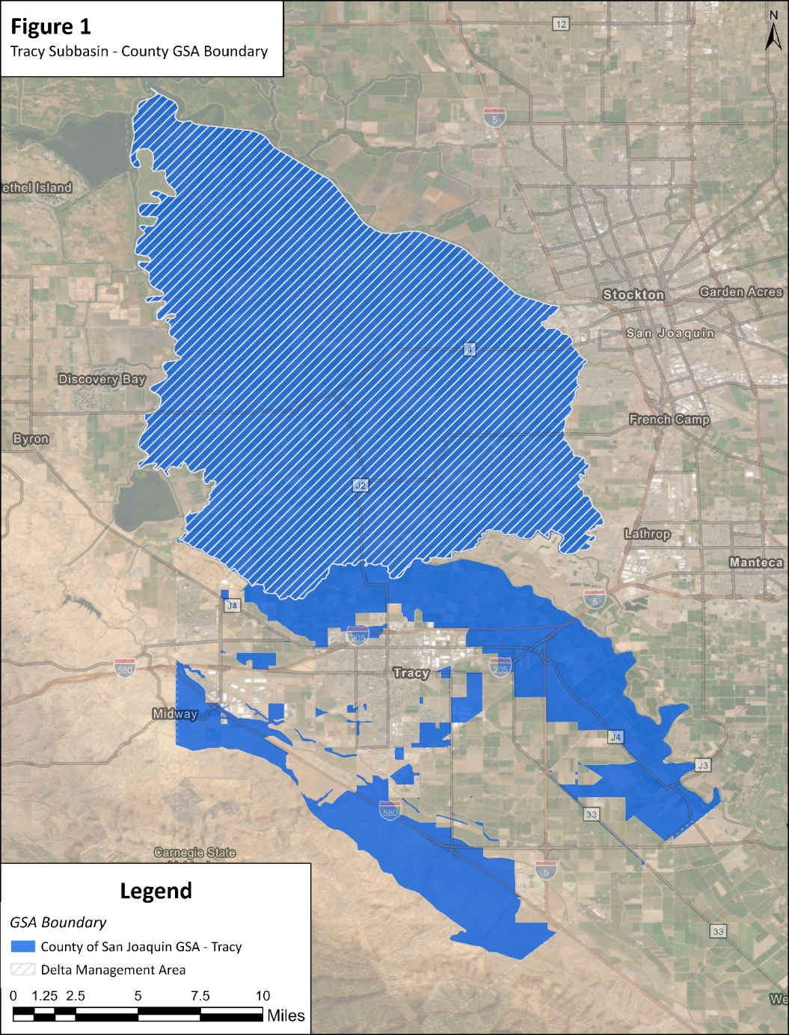
County GSA in Tracy Subbasin
Tracy Subbasin GSP Coordinating Committee
  Created by Memorandum of Agreement (MOA) in 2019 – established approach for funding Committee
  6 Groundwater Sustainability Agencies (GSAs)
Develops and implements a single basin-wide Groundwater Sustainability Plan (GSP)
Supports Sustainable Groundwater Management Act (SGMA) compliance
  Ongoing funding (monitoring, modeling, reporting, administration)
County GSA (159,000 acres) participates and pays proportional share of compliance costs (dues)
  Delta Management Area
  Non-Delta Management Area

Slide 3
Tracy Subbasin
County GSA Funding Approach
County GSA share of compliance costs historically funded by Zone 2
Zone 2 is a property-related fee paid by all SJC property owners to support county’s Strategic Plan to Meet Water Needs, adopted in 2015
Proposed regulatory fee would align costs with beneficiaries/groundwater users within County GSA in Tracy Subbasin

Slide 4
County GSA in Tracy Subbasin
Proposed Funding Solution
Adopt regulatory fee for SGMA Compliance within County GSA boundary
  Fund SGMA regulatory compliance cost (Tracy Subbasin GSP Coordinating Committee dues)
  Cover costs to administer and adopt regulatory fee
Applies to ~1,460 properties
Collected annually on property tax roll/direct billing to special districts
Water Code§10730 et seq. and California Constitution Article XIII C (Proposition 26)
Notes:
Fee must qualify as regulatory fee (not a tax)
Must not exceed reasonable cost of providing service
Must have nexus between cost and benefit/burden
Authorized under Water Code §10730(a) for groundwater sustainability programs

Slide 5
Proposed Regulatory Fee
Allowable Expenditures and Limitations
 | Administration (governance, legal, finance, coordination)
 | GSP amendments/updates, 5-year periodic evaluations, & annual reports
 | Groundwater modeling and water budgets
 | Monitoring networks and data systems
 | Coordination with DWR and State Water Board
 | Public outreach and stakeholder engagement
 | Capital or infrastructure projects

Slide 6
County GSA in Tracy Subbasin
Proposed Fee Budget Overview (FY 26/27)
Total fee budget ($149,600) split between Delta Management Area (MA) and Non-Delta MA
Delta MA: $24,400
  FY 25/26 Tracy Subbasin GSP Coordinating Committee dues: $18,000
    Reflects cost of 3 Delta MA-specific required corrective actions from DWR for annual monitoring only
  Administrative costs including consultant costs: $6,400
Non-Delta MA: $125,200
  FY 25/26 Tracy Subbasin GSP Coordinating Committee dues: $92,200
  Administrative costs including consultant costs: $33,000
Fee calculation will be updated annually based on Tracy Subbasin GSP Coordinating Committee dues and related consultant costs to administer and collect the fee
  Consultant costs will be substantially less in future years

Slide 7
County GSA in Tracy Subbasin
Proposed Fee Structure Overview
Delta MA
      Acreage fee only
Non-Delta MA
  Three components of fee formula applied to non-exempt parcels:
      Acreage component ($10,000 base cost recovery)
      Pumping component (60% weighting)
      Population component (40% weighting)
  Proportionally allocates costs to property owners based on groundwater demand drivers

Slide 8
County GSA in Tracy Subbasin
Acreage Component
Delta MA
  Allocates $24,400 to acreage in Delta MA (103,000 acres)
  FY 26/27 Rate: $0.24 per acre
Non-Delta MA
  Allocates $10,000 minimum Tracy dues across all Non-Delta MA acres (39,800 acres)
  Uniform cost per acre regardless of land use
  FY 26/27 Rate: $0.26 per acre

Slide 9
County GSA in Tracy Subbasin
Pumping Component (Non-Delta MA only)
Represents groundwater demand (60% of remaining budget)
Land use–based pumping demand factors (acre-feet per year per acre)
  Demand factors align with North San Joaquin Water Conservation District Assessment Engineer’s Report
Examples:
  Orchard: ~2.8 afy/acre
  Row crops: ~2.2 afy/acre
  Rural Residential ≥5 acres: ~2.5 afy/acre
FY 26/27 Pumping Rate: $1.16 per acre-foot

Slide 10
County GSA in Tracy Subbasin
Population Component (Non-Delta MA only)
Represents population-related demand (40% of remaining budget)
Residential: persons per housing unit (PPHU) based on latest US Census Data for San Joaquin County
Non-residential: employees per 1,000 sq. ft.
Examples:
  Residential: ~3.3 persons/unit
  Commercial: ~2.2 employees/1000 sq. ft.
FY 26/27 Rate: $9.66 per person equivalent

Slide 11
County GSA in Tracy Subbasin
Special Handling for CSAs and MDs
Parcels serviced by County Service Areas (CSAs) and Maintenance Districts (MDs) that pump groundwater are not billed individually
Fees calculated at District level due to centralized groundwater pumping
Uses actual measured pumping (5-year average)
Estimated population and acreage aggregated at District level
Ensures proportional allocation based on actual system use

Slide 12
County GSA in Tracy Subbasin
Proposed Regulatory Fee Distribution
(Delta MA)
Agricultural: $24,637 (99.6%)
Rural Residential: $39 (0.2%)
Multi Family Residential: $3 (0.0%)
Commercial/Office/Industrial: $53 (0.2%)
CSAs & MDs: $0 (0%)
Total: $24,731
Notes:
Table 5B from the Rpt

Slide 13
County GSA in Tracy Subbasin
Proposed Regulatory Fee Distribution
(Non-Delta MA)
Agricultural: $78,625 (62.5%)
Rural Residential: $3,934 (3.1%)
Commercial/Office/Industrial: $12,688 (10%)
CSAs & MDs: $27,361 (21.8%)
Total: $125,787

Slide 14
County GSA in Tracy Subbasin
Proposed Regulatory Fee Exemptions
5,330 parcels in County GSA in Tracy Subbasin
  1,460 parcels subject to the proposed regulatory fee
Exempt parcels:
  Residential parcels <5 acres (de minimis groundwater extractors; not subject to SGMA)
  Vacant land and utility parcels
  Parcels in special districts served only by surface water
Special fee component exemptions:
  Parks exempt from population component

Slide 15
County GSA in Tracy Subbasin
Proposed Regulatory Fee Examples
(Delta MA)
50-acre irrigated orchard: ~$12/year
Notes:
Table 4B, $0.24/Ac; for 50 ac -$12.
Table 3B Commercial 29 parcels; Rural Residential 20 parcels, Multi-family Residential parcel 1;
Table 5B Commercial $53/29: ~$2; $41/21:~$2

Slide 16
County GSA in Tracy Subbasin
Proposed Regulatory Fee Examples
(Non-Delta MA)
50-acre irrigated orchard: ~$175/year
Commercial parcel (1 acre; 6,000 sq. ft.): ~$130/year
Rural residential (10 acres): ~$63/year
Small residential (<5 acres): Exempt

Slide 17
County GSA in Tracy Subbasin
Proposed Regulatory Fee
Key Takeaways
Fee would provide funding for SGMA regulatory compliance
Based on measurable drivers: acreage, pumping, & population
Aligns costs with groundwater users
Includes an appeal process
  Limited to land use classifications
Legally compliant under Proposition 26

Slide 18
Questions/Discussion
Seth Wurzel
Larsen Wurzel & Associates, Inc.
seth@larsenwurzel.com
(916) 698-5712

