Slide 1
San Joaquin County
Advisory Water Commission Update
Darren Suen, P.E., PMP
Executive Director
May 20, 2026

Slide 2
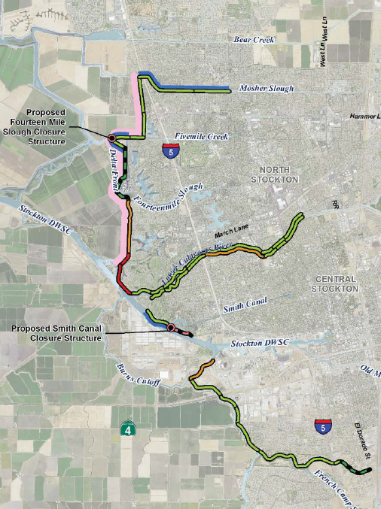

USACE Lower San Joaquin River Project (LSJRP)
– Phase 1
Feasibility Study Completed in 2018 and resulted in a $2 billion flood risk reduction plan for North and Central Stockton
Construction of 1st segment (TS30L) is underway
Shima Tract begin construction 2028 latest
Mitigation sites acquired
Design Charette May 21st
San Joaquin County
Advisory Water Commission Update
Darren Suen, P.E., PMP
Executive Director
May 20, 2026

Slide 3
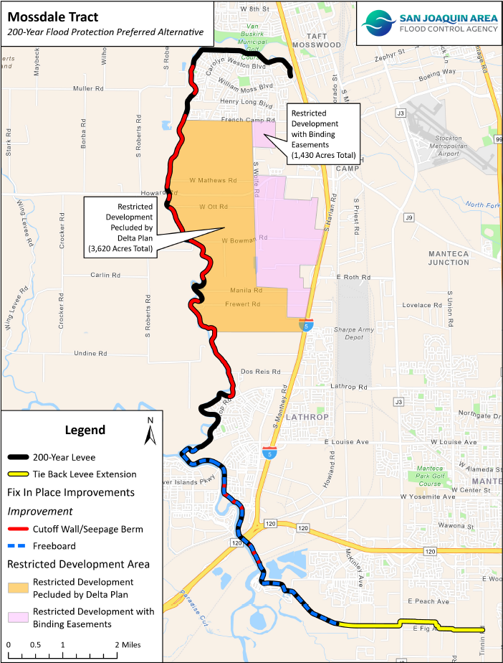
Mossdale Tract Area – UFRR vs USACE Study
Mossdale Tract Area Urban Flood Risk Reduction (UFRR) Study was completed in collaboration with the State in 2021
Dry land levee construction 2027
Transitioning from USACE Study to Section 203 (SJAFCA/State led study)
San Joaquin County
Advisory Water Commission Update
Darren Suen, P.E., PMP
Executive Director
May 20, 2026

Slide 4
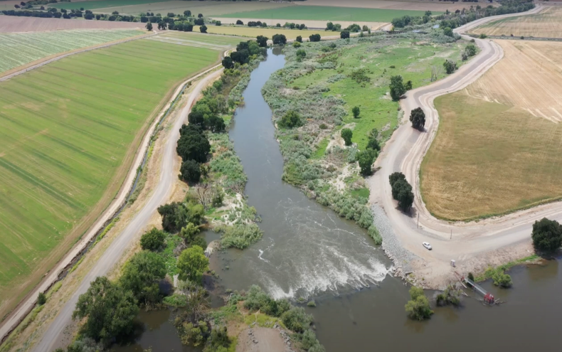
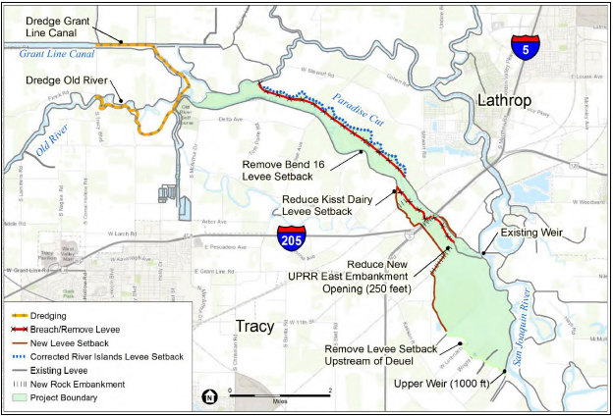
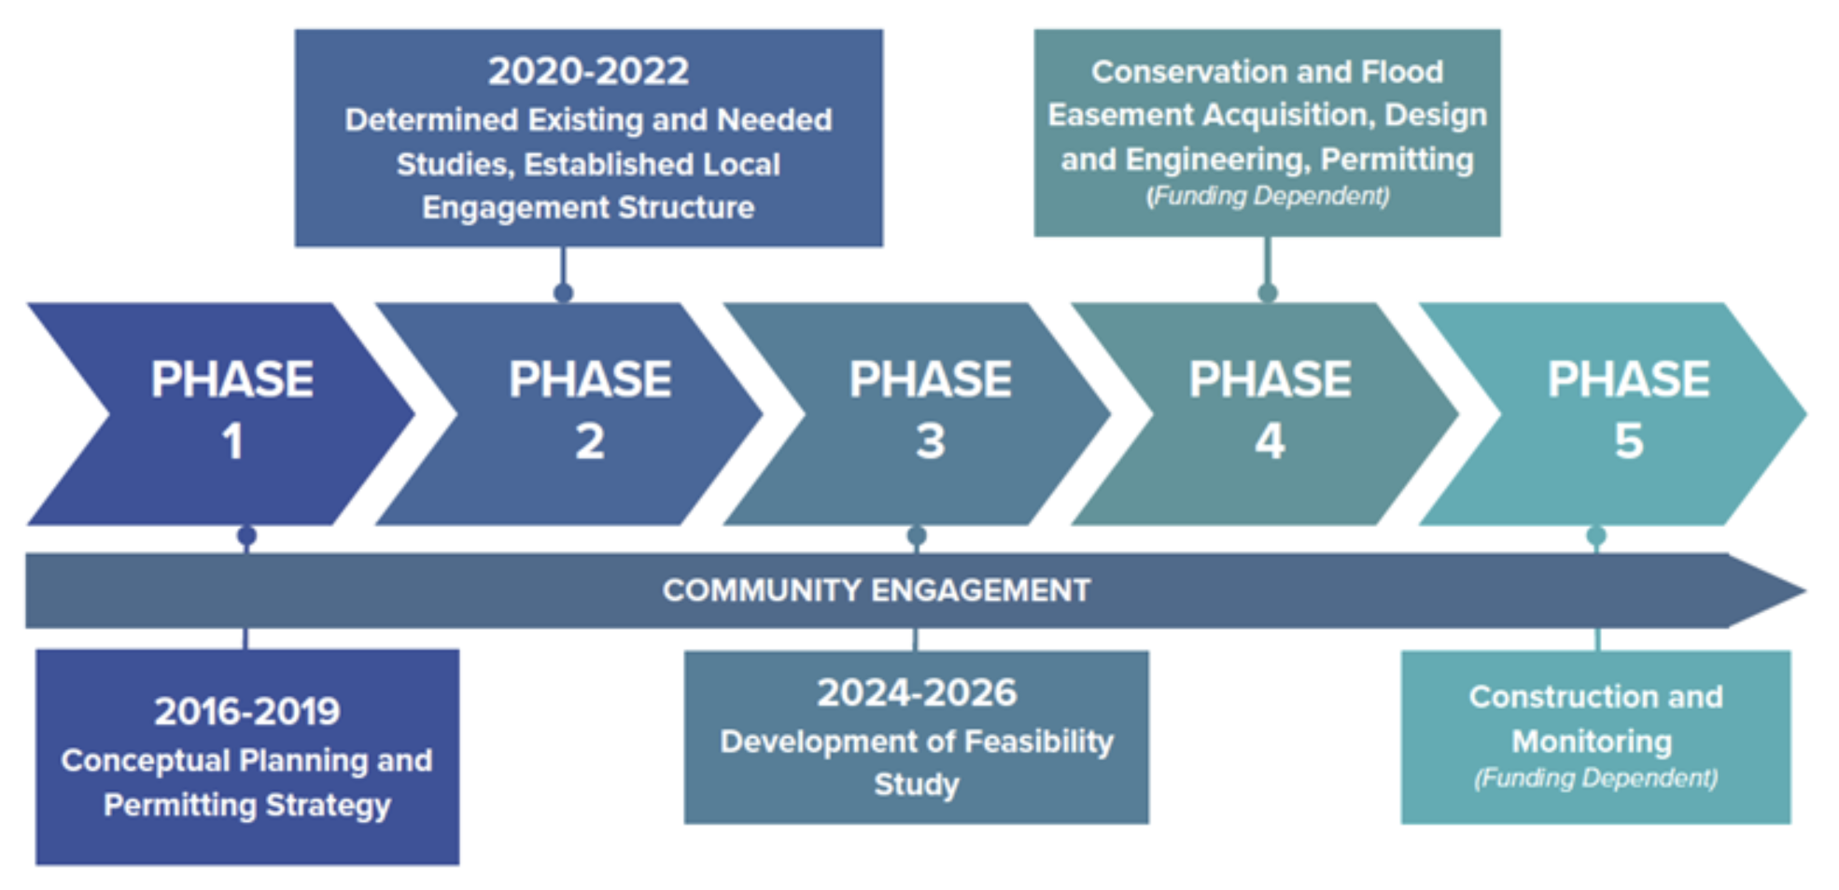
Paradise Cut Bypass Expansion
DWR and SJAFCA are currently conducting a feasibility study on the expansion and ecosystem restoration of Paradise Cut
San Joaquin County
Advisory Water Commission Update
Darren Suen, P.E., PMP
Executive Director
May 20, 2026

Slide 5
Questions & Discussion

