Slide 1



San Joaquin County’s 26th Annual Coastal Cleanup Day
Event Date: September 20, 2025 · 9 AM-12 PM

Slide 2

Introduction to Coastal Cleanup
Celebrating 40 Years of Coastal Stewardship
San Joaquin County’s 26th Year of Participation
Held annually on the 3rd Saturday of September
Part of the International Coastal Cleanup (ICC) led by the Ocean Conservancy
  The ICC now includes 45 states, Washington D.C., and over 100 countries!
California Coastal Commission serves as the Statewide Coordinator
San Joaquin County participates through local coordination and community partnerships

Slide 3
How It Works
The County Coordinator recruits Site Captains
Site Captains recruit volunteers for local cleanup sites
Volunteers work three hours to collect and record debris data
Cleanup Impact (California)
Since 1985, over 1.7 million volunteers have removed nearly 27 million pounds of trash from California’s waterways
(California Coastal Commission, 2024 Final Results Report)
In 2024, 45,672 volunteers collected 376,308 pounds of debris statewide
(Source: California Coastal Commission — 2024 Final Results Report)
🌎 Each year, thousands join forces to protect our waterways — proving that small actions add up to big change!

Slide 4

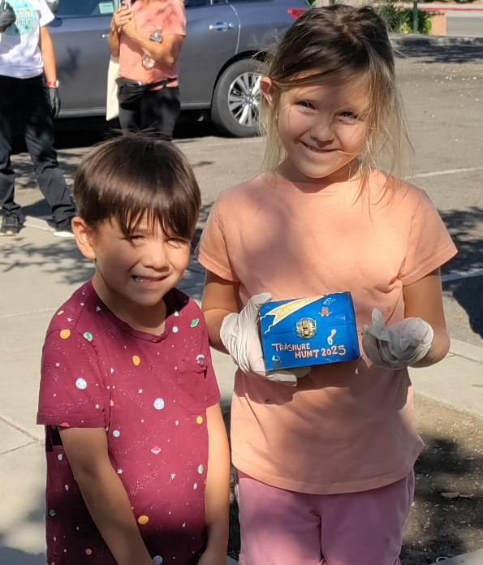
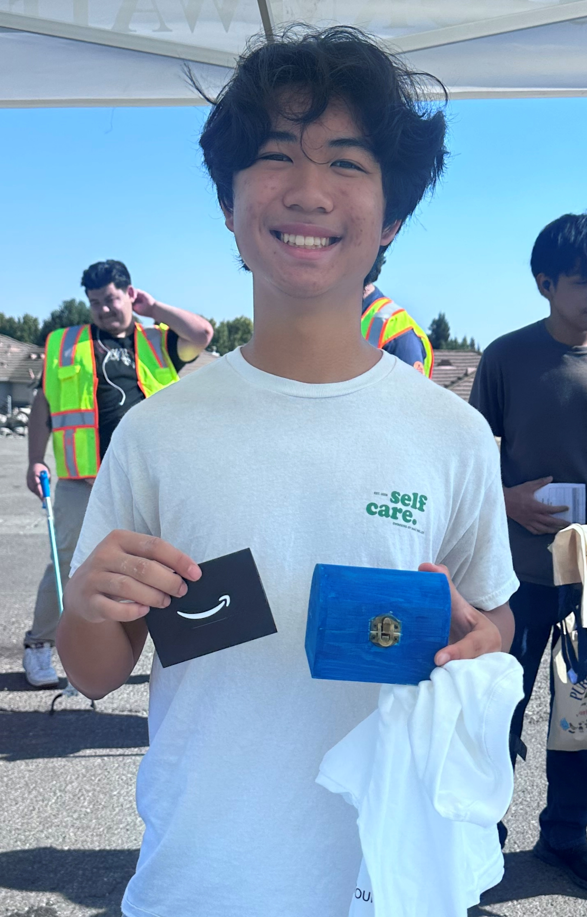
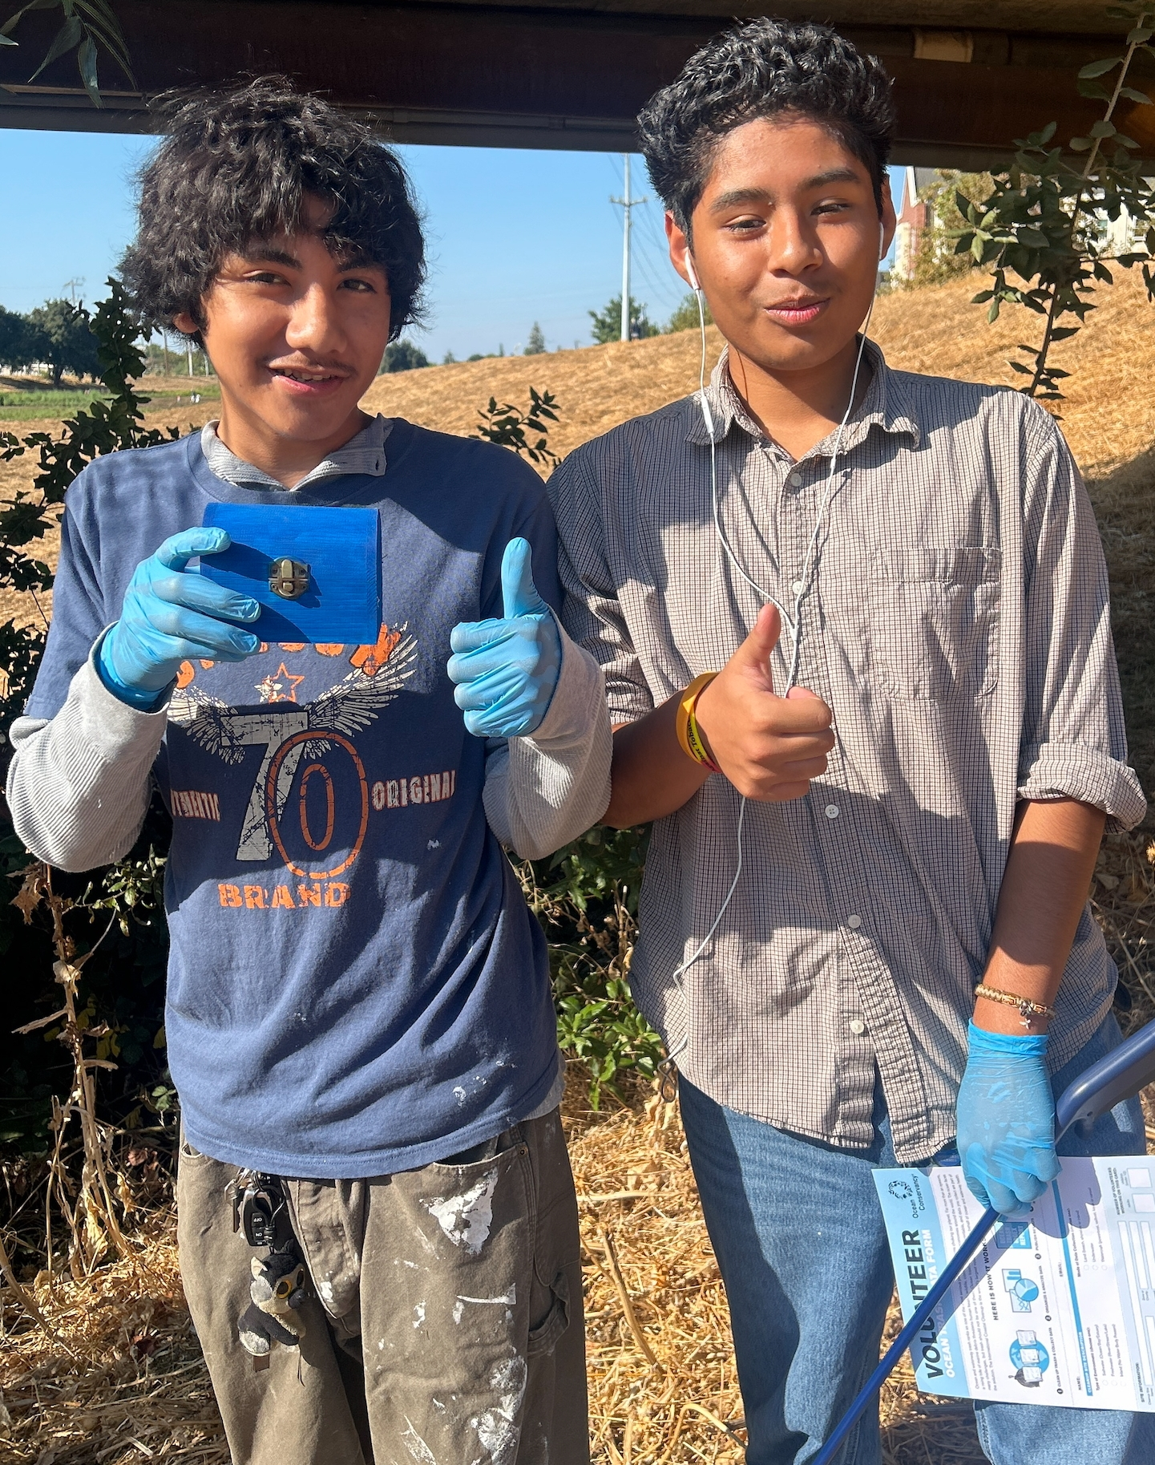
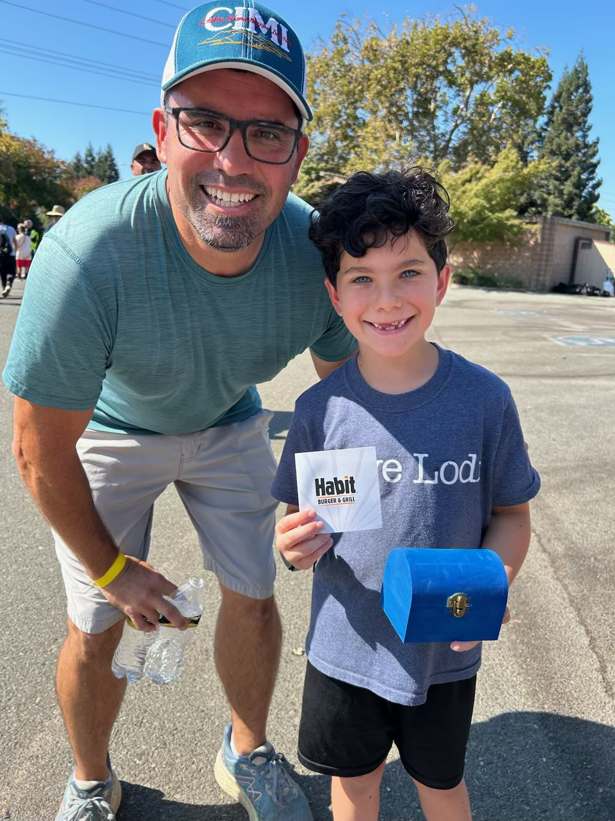

Slide 5
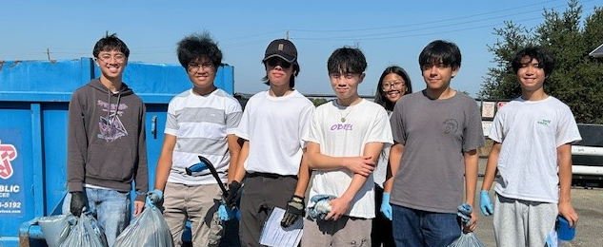
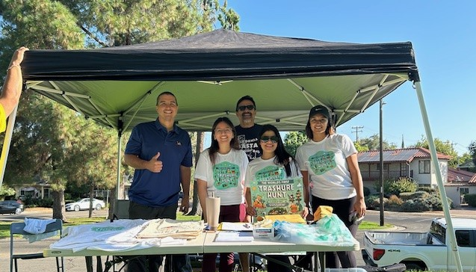
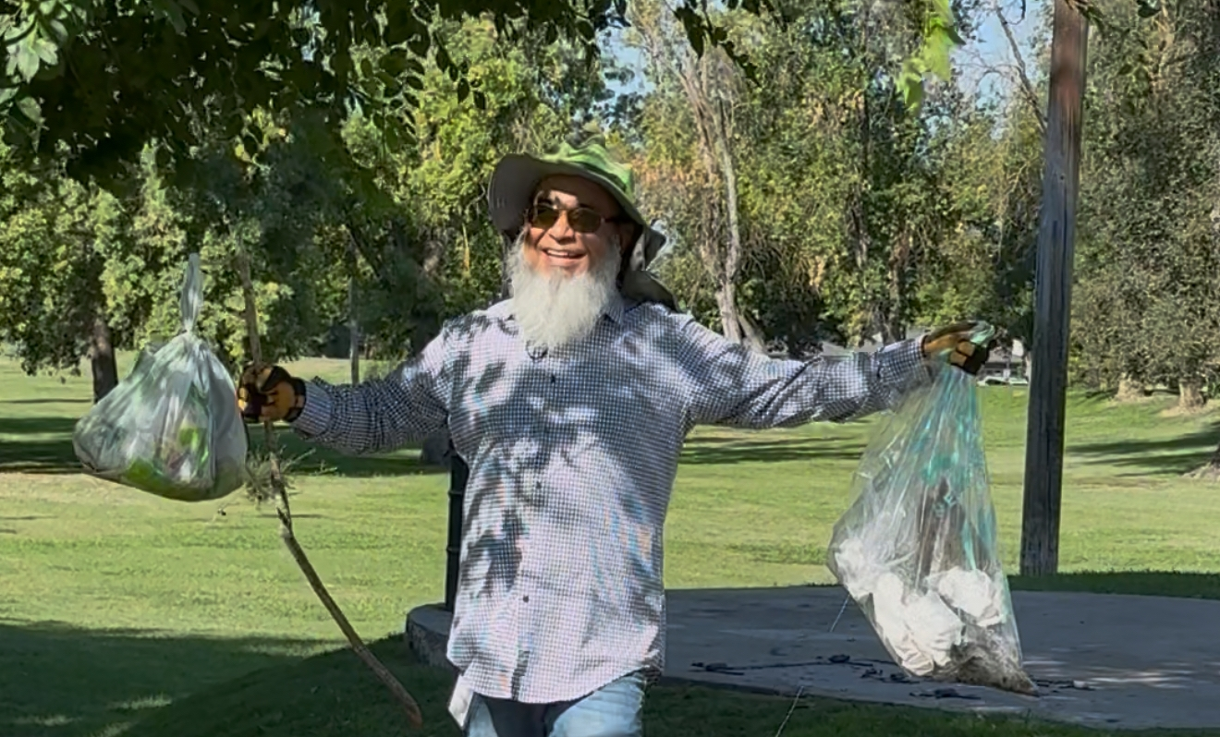
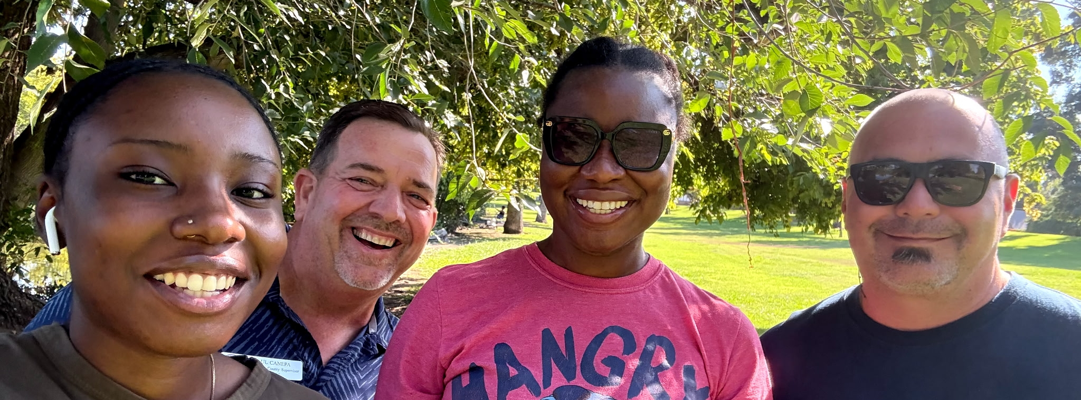

Slide 6
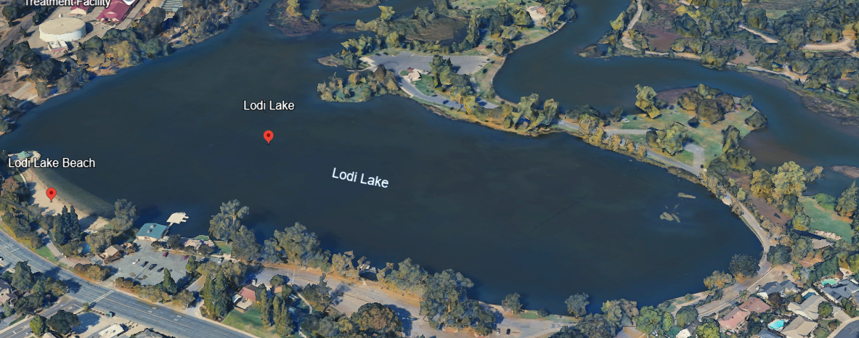
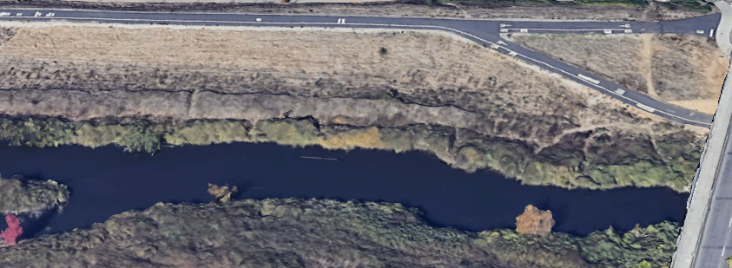
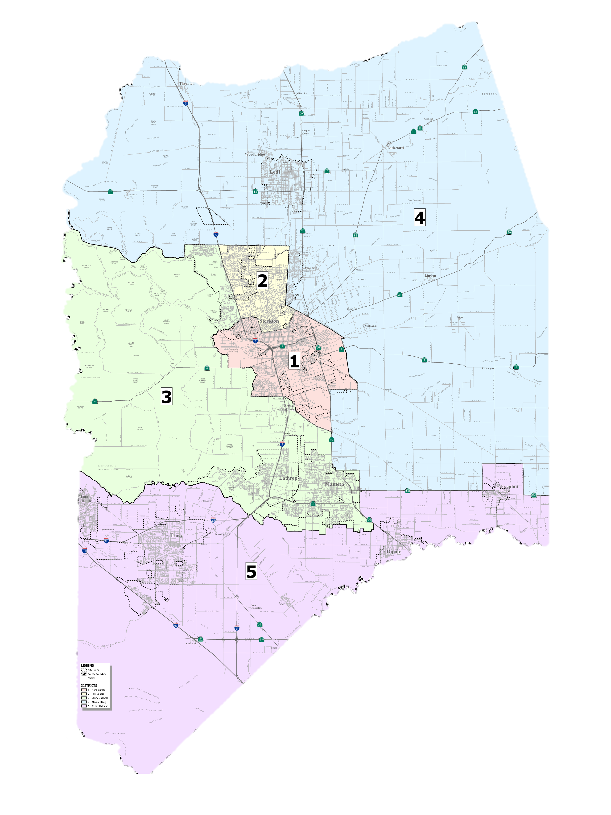
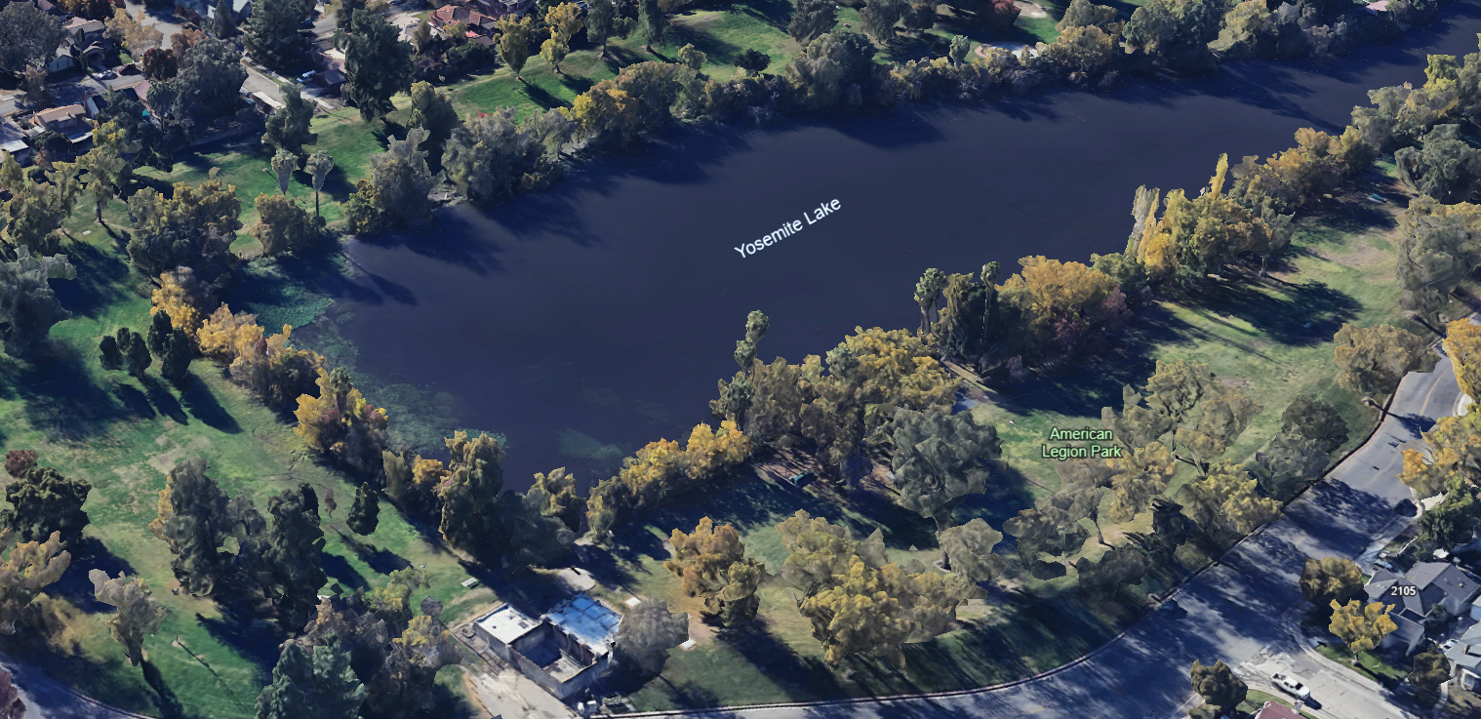
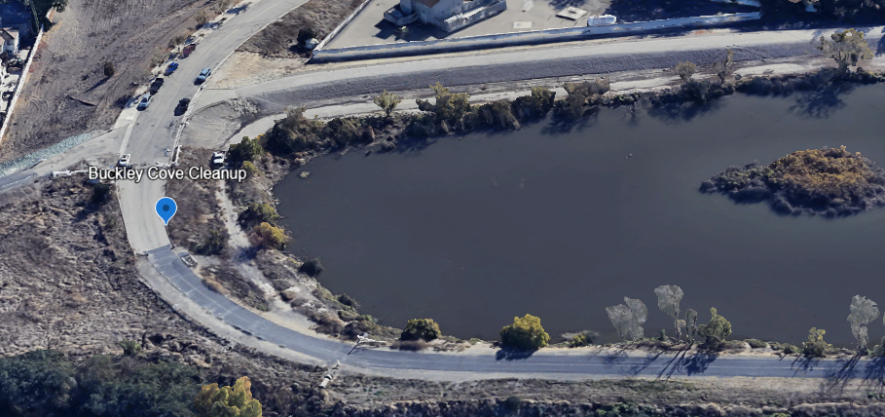
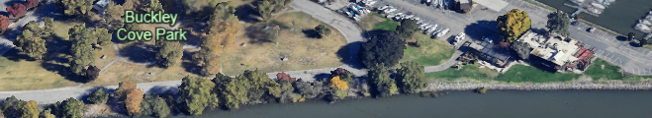
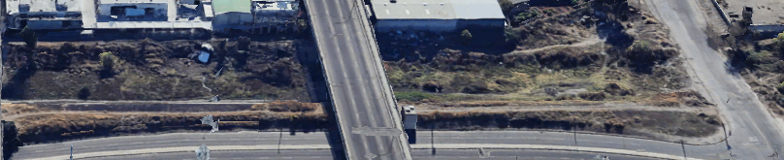
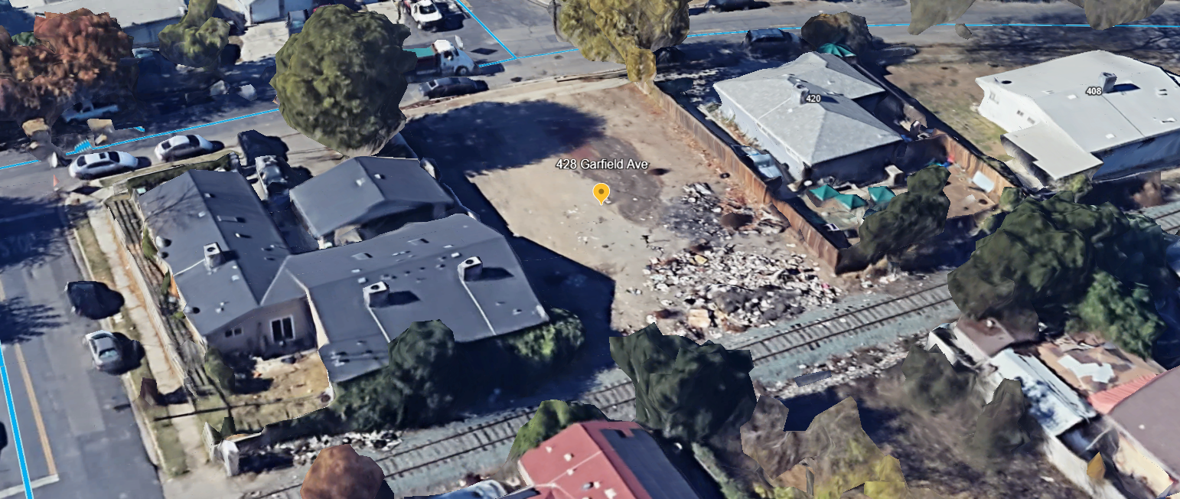
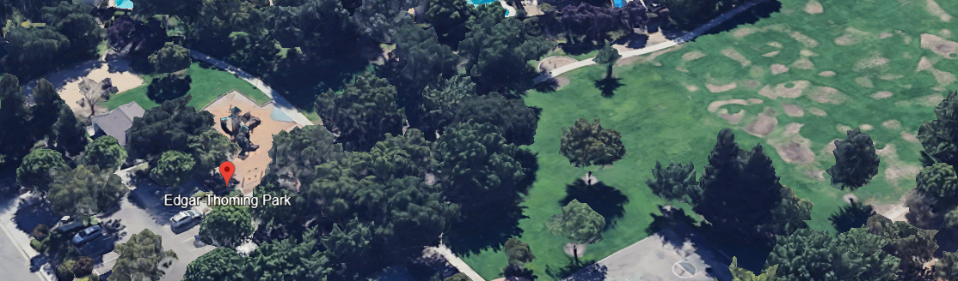
Site Locations
Lodi Lake
Calaveras Bridge
Buckley Cove
American Legion Park
Ladd’s Marina
Mormon Slough
Edgar Thoming Park
Garfield Ave.

Slide 7
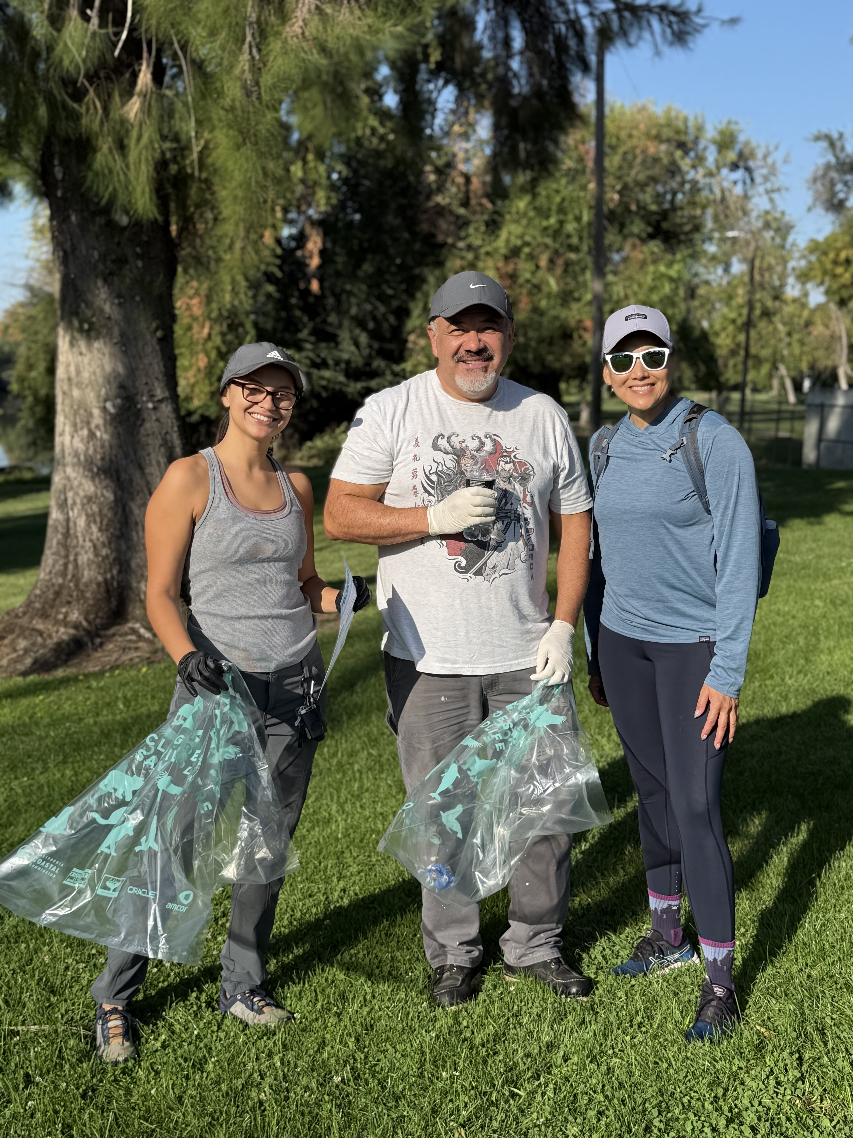
American Legion Park
Site | Captain | Trash (lbs) | Volunteers | Miles Covered | District
American Legion Park | Angie Provencio | 40 | 11 | 1.5 | 2

Slide 8
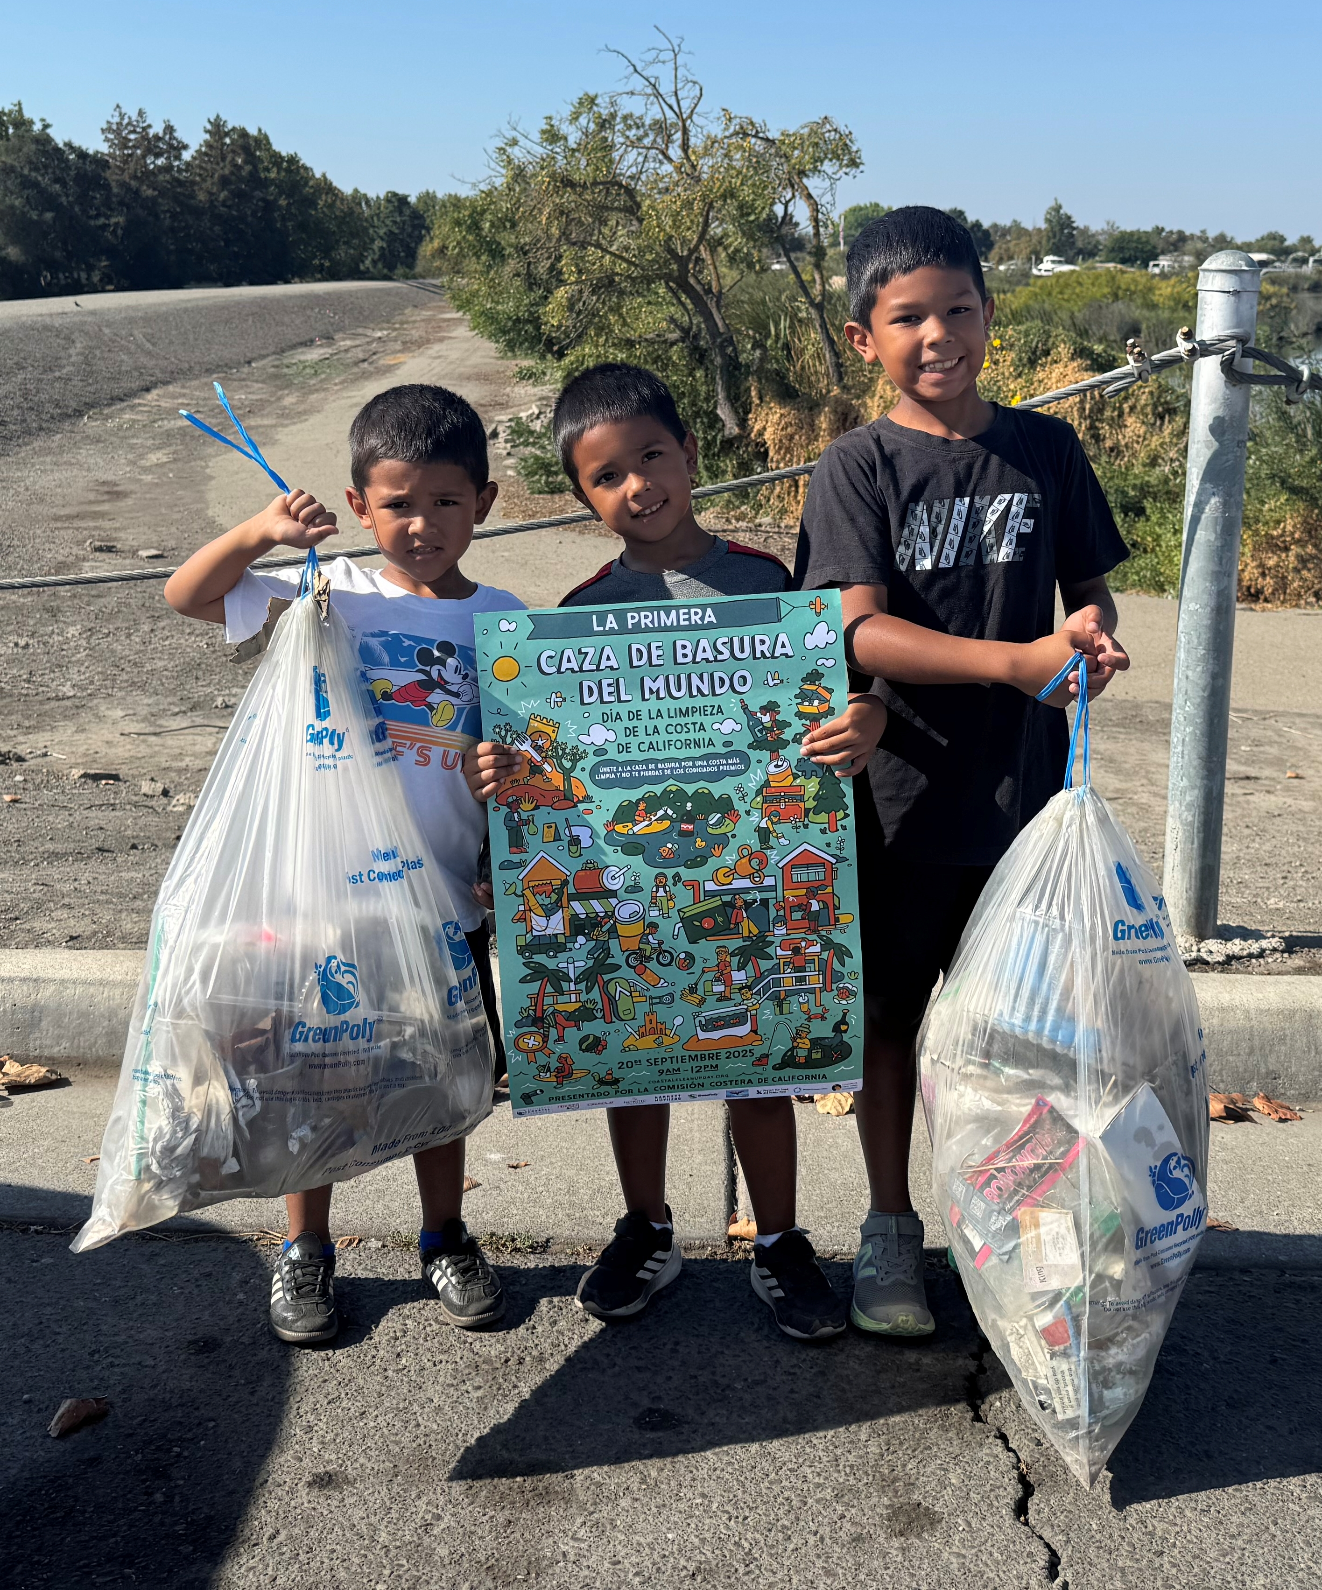
Buckley Cove
Site | Captain | Trash (lbs) | Volunteers | Miles Covered | District
Buckley Cove | Dagmara Saina | 422 | 50 | 3 | 3

Slide 9
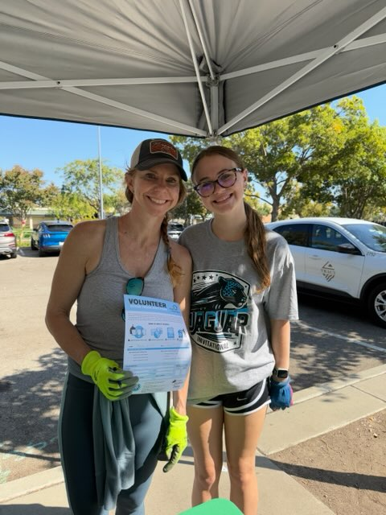
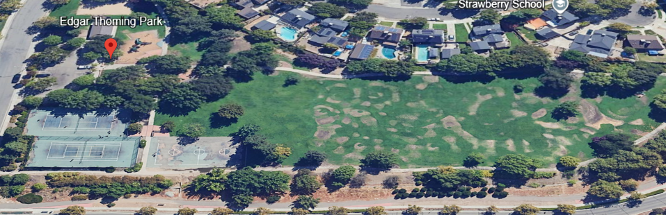
Edgar Thoming Park
Site | Captain | Trash (lbs) | Volunteers | Miles Covered | District
Edgar Thorning Park | Heather Fernandez | 50 | 14 | 1 | 5

Slide 10
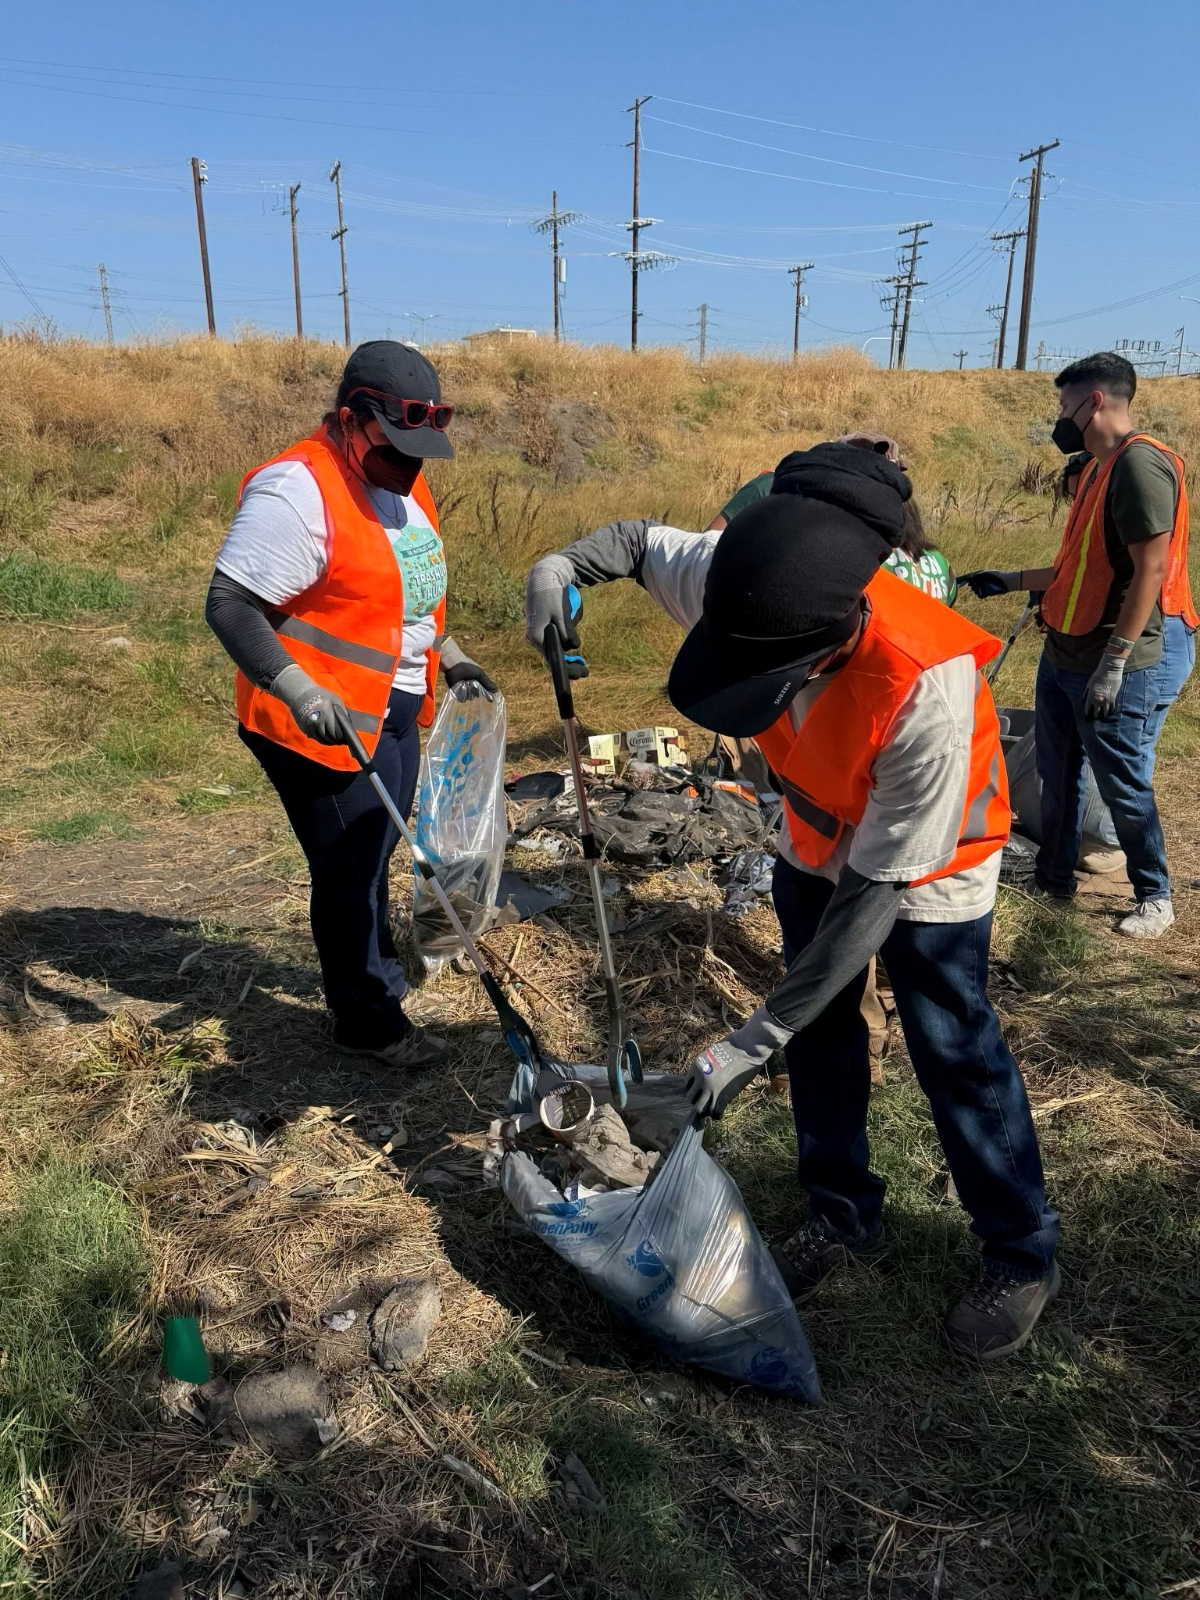
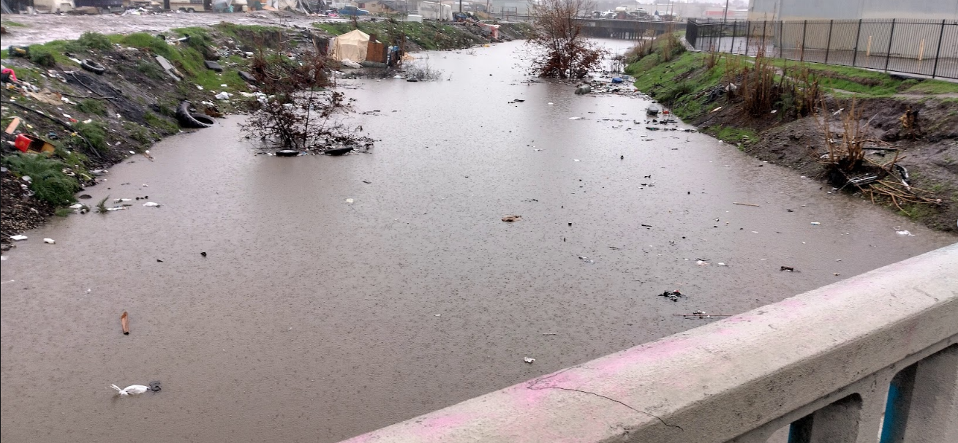
Mormon Slough
Site | Captain | Trash (lbs) | Volunteers | Miles Covered | District
Mormon Slough | Artie Valencia | 890 | 44 | 1 | 1
10

Slide 11
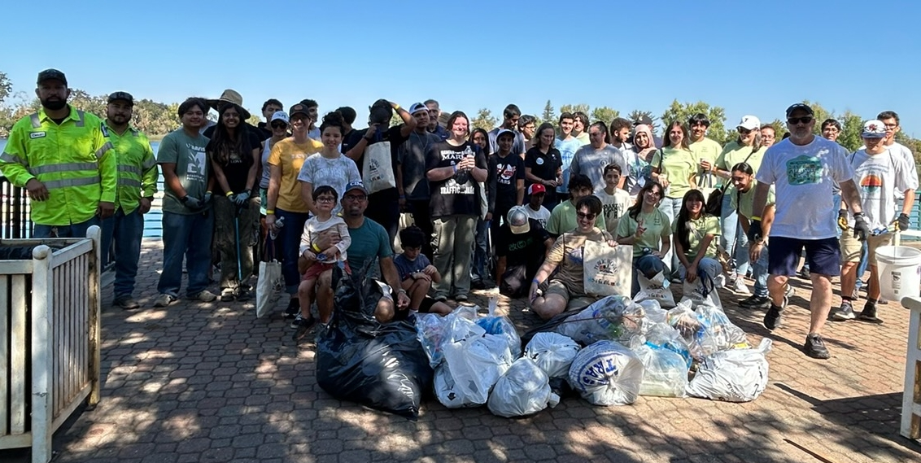
Lodi Lake
Site | Captain | Trash (lbs) | Volunteers | Miles Covered | District
Lodi Lake | Kathy Grant | 362 | 106 | 5 | 2

Slide 12
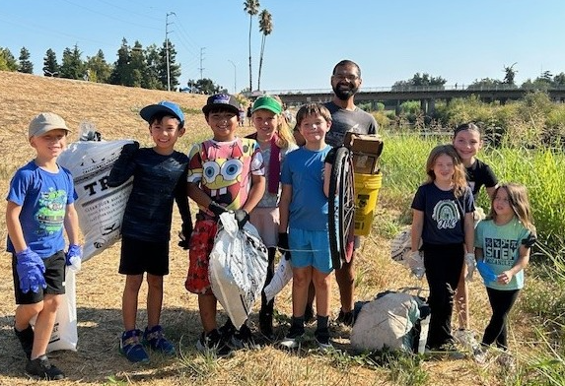
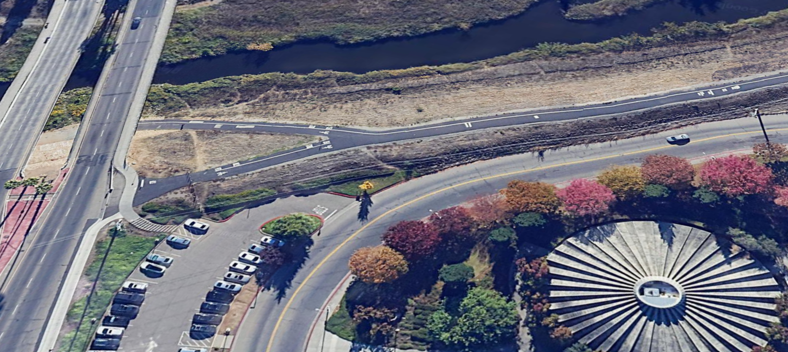
Calaveras Bridge
Site | Site Captain | Trash (lbs) | Volunteers | Miles Covered | District
Calaveras Bridge | Antonia Hernandez | 705 | 87 | 5 | 1

Slide 13
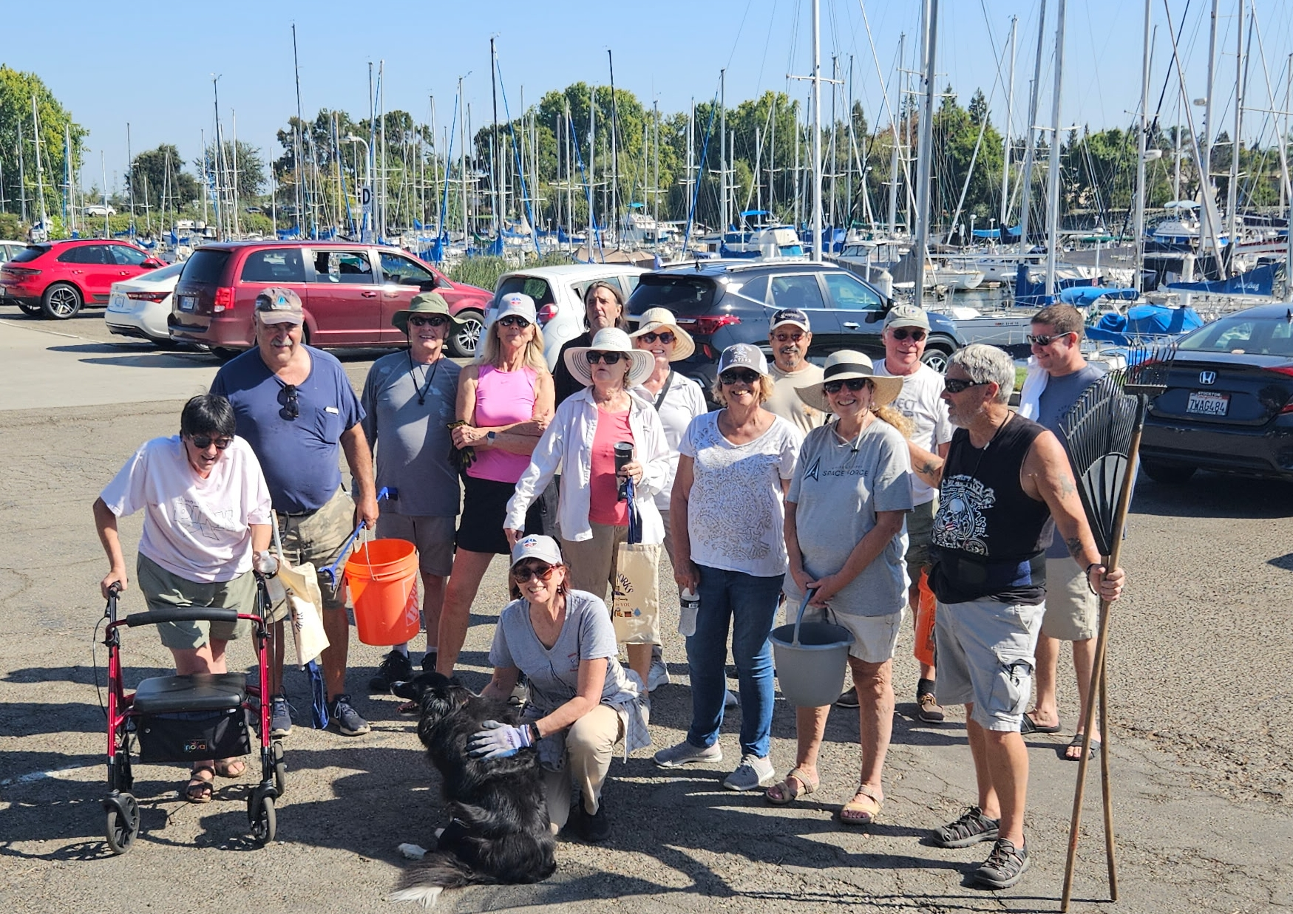
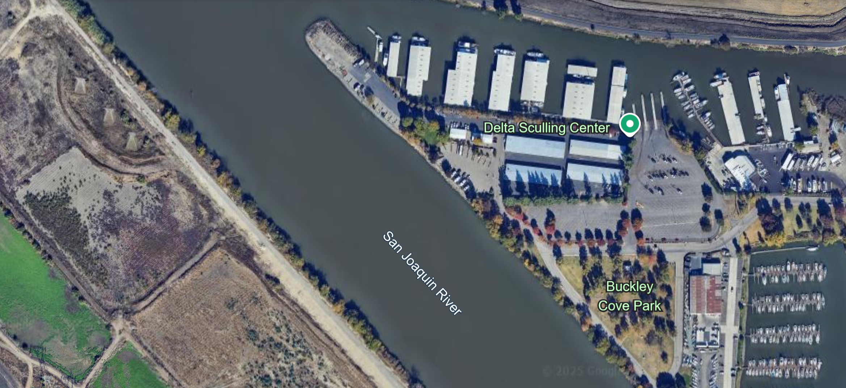
Ladd’s Marina
Site | Site Captain | Trash (lbs) | Volunteers | Miles Covered | District
Ladd’s Marina | Faye Roberts | 200 | 16 | 2 | 3

Slide 14
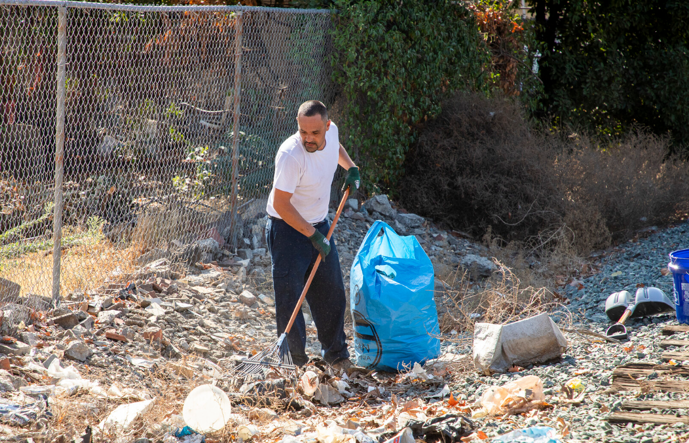
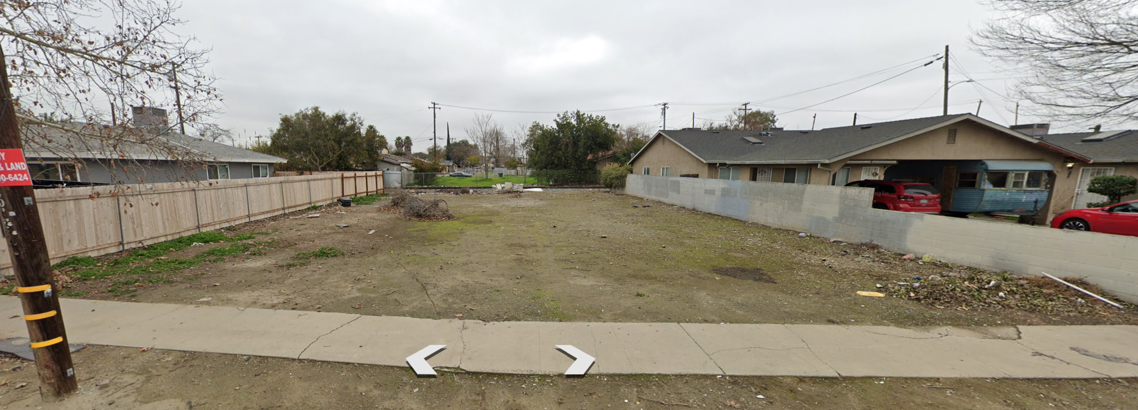
Port of Stockton
Site | Site Captain | Trash (lbs) | Volunteers | Miles Covered | District
Port of Stockton | Julia Ulm | 3,500 | 25 | 0.5 | 1

Slide 15
Event Highlights
Metric | 2024 | 2025
Number of Sites | 8 | 8
Total Trash Collected (lbs) | 10,479 | 6,169
Number of Volunteers | 497 | 357
Total Miles Covered | 13.8 | 19

Slide 16





Thank You Sponsors!

Slide 17
For site suggestions or questions, you can reach me (Selinda Centeno) at scenteno@sjgov.org or 209-468-3560

