Slide 1

San Joaquin County
Advisory Water Commission
May 20, 2026
Fall 2025 Semiannual
Groundwater Monitoring Report

Slide 2
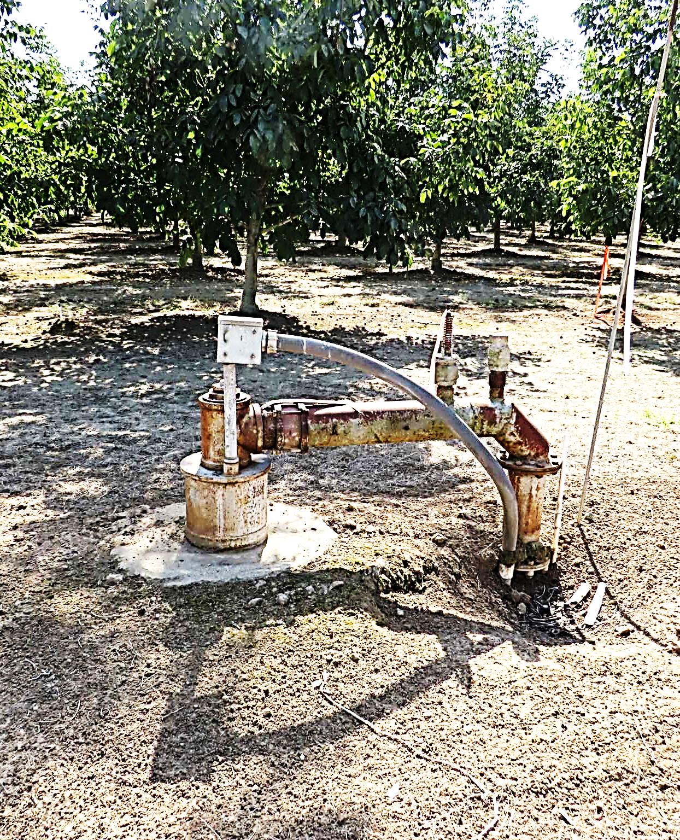

Fall 2025 Groundwater Report
Presentation Outline
Program overview
Sustainable Groundwater Management Act of 2014 (SGMA)
Hydrologic setting (Fall 2024 - Fall 2025)
Fall 2025 groundwater level measurements
  Comparison to Fall 2024 measurements

Slide 3
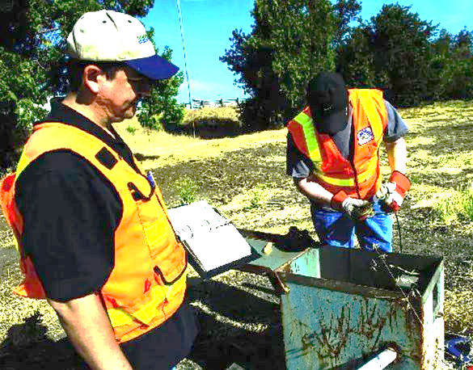
Groundwater Monitoring Program Overview
San Joaquin County has measured groundwater levels semiannually since 1971
  Data stored in Water Resources Division databases
Measurements taken at over 250 monitoring wells and production wells each Spring and Fall
  Attempt to capture annual high groundwater levels in the Spring and annual low groundwater levels in the Fall
  Corrective measurements to replace data affected by local groundwater pumping within same season
  Professional judgment applied when control measures are insufficient to retain quality regional data
Notes:
99% of wells monitored are production wells, there is no dedicated monitoring well network.
Monitoring wells are USGS or city owned, only about a dozen of them in ESJ subbasin that report water quality and most are not monitored by county staff.
Data challenges arise when production wells are pumping during the measurement period.
Previously, groundwater reporting would be data driven with little analytical corrections “post the data”.
After years of slight refinements to reporting, further analyses and controls are put in place to filter data that is affected by groundwater pumping, previously, these data points were noted as being affected but were removed from regional contouring of data and averages for wells that stood out in contouring data, NOW; all wells are held to same scrutiny to maintain a realistic shape of the groundwater depression and regional accuracy.

Slide 4
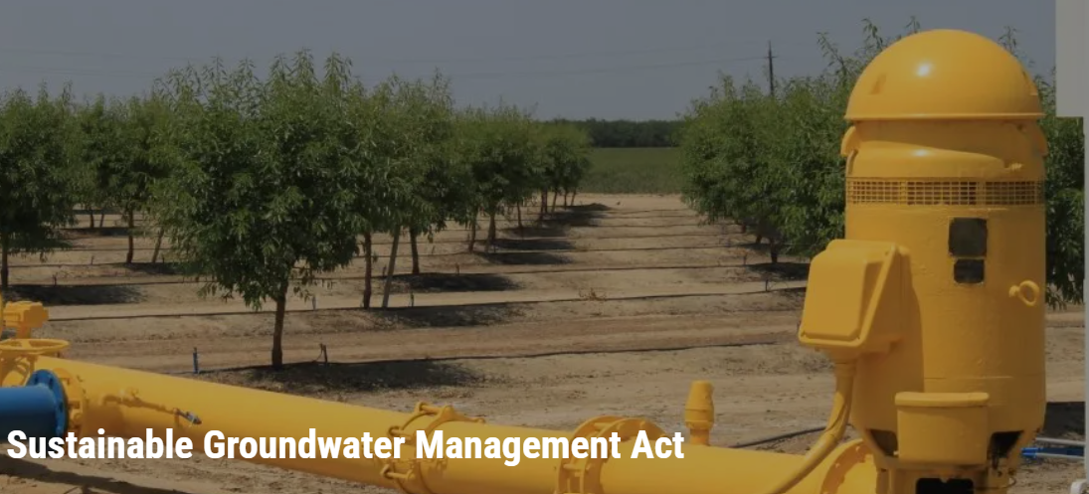
Groundwater Monitoring Program Overview
2014 California Sustainable Groundwater Management Act (SGMA)
  High-priority, critically overdrafted subbasins such as the Eastern San Joaquin Subbasin must achieve sustainable yield by 2040
  Medium-priority subbasins such as the Tracy Subbasin must achieve sustainable yield by 2042

Slide 5
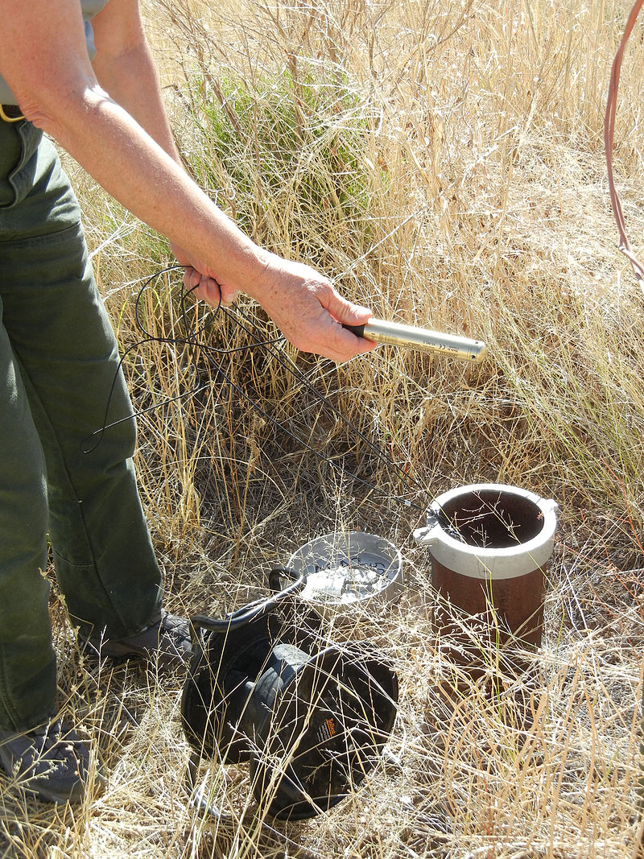
Groundwater Monitoring Program Overview
2014 California Sustainable Groundwater Management Act (SGMA)
  SGMA requires semiannual measurements for certain wells specified in Groundwater Sustainability Plans (GSPs) for the Eastern San Joaquin Subbasin and Tracy Subbasin
  Used (among other factors) to evaluate regulatory compliance
Notes:
GEI has been reporting groundwater conditions in the ESJ and TSb since 2020, Fall 2017 was the beginning of this new era of biannual reporting.
2020 and 2021 were combined into full annual reports due to COVID.
These reports are not SGMA but aim to cover the inadequacies of the ESJ GSP.
The ESJ GSP groundwater conditions and monitoring network is based on a small subset of wells (about 25 wells) that were used to inform their groundwater modelling software. Their schedule of releasing updates follows the SGMA timetable and doesn’t show changes year to year or seasonally. The monitoring network in the GSP is about 1/10th the size of what the county measures twice a year.
GEI has been reporting physical data provided by the county measuring over 250 wells as well as incorporating statewide data available from DWR, USGS, and meteorological databases on a biannual schedule.

Slide 6
Hydrologic Setting
(Fall 2024 - Fall 2025)
2024 was classified as a Normal water year at 90% of normal rainfall, while 2025 was preliminarily classified as a Below Normal water year at 50-60% of normal rainfall
Precipitation within the county was about 30-40% less in 2025 than in 2024
Reservoir releases/river flows varied, but were generally similar to precipitation—about 30-40% lower than 2024
Notes:
Changes in groundwater levels across the basin are more significant when going from a wet year to a dry year, than a dry year to another dry year.
Expect larger declines between 2023 and 2024 than 2024 and 2025.

Slide 7
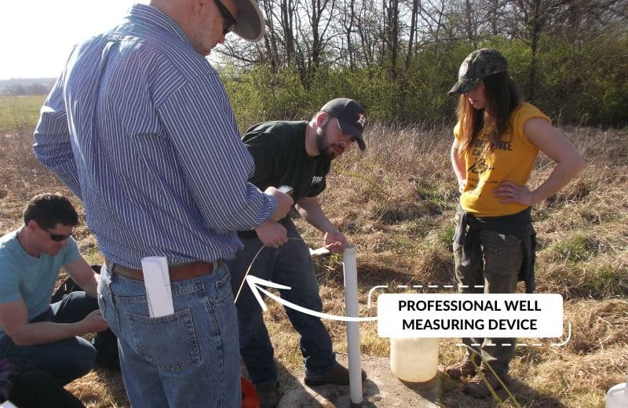
Fall 2025 Groundwater Level Measurements

Slide 8
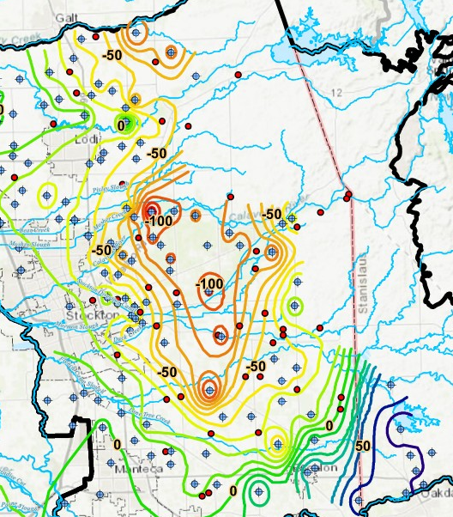
Fall 2025 Groundwater Elevations
(feet, MSL)
Notes:
Clearer representation of measured wells, the red locations are where measurements were attempted but could not be collected for a variety of reasons.
December readings replaced data affected by pumping in October in both contours and analyses tables, GEI applied professional judgement to remove data points that got through the steps the County implemented to control quality of data.
The shape of the groundwater depression changed due to measurements not able to be collected or affected by pumping in 2024.
Overall, 2024 data was not put under the same level of scrutiny as Fall 2025 data has been.
The depression looks smaller in Fall of 2025 than in Fall of 2024. This happens when adding or removing wells, unable to collect measurements from wells, or removing well data due to groundwater pumping at the time of measurement. These issues have affected the visual interpretation and shape of the depression every year.
EXTRA INFO – not included in this report.
GEI is working on a method to retain an “average” groundwater level for each location in-lieu of a bad or uncollected measurement; to help retain the shape and size of the groundwater topography in the subbasin, this will be denoted on future maps in a similar way as the “No Measurement” locations, but the contours will retain the “ghost” of the missing wells data using the 5 most recent seasonal measurements at the wellsite (e.g. if no measurement in Fall 2025, but we have measurements for Falls of 20 through 24, we will average that water level data and use the average increase or decrease of the region to assign the missing well a measurement in the contours.
This process should hopefully increase the resolution of the depression and cover data gaps that sporadically appear.

Slide 9
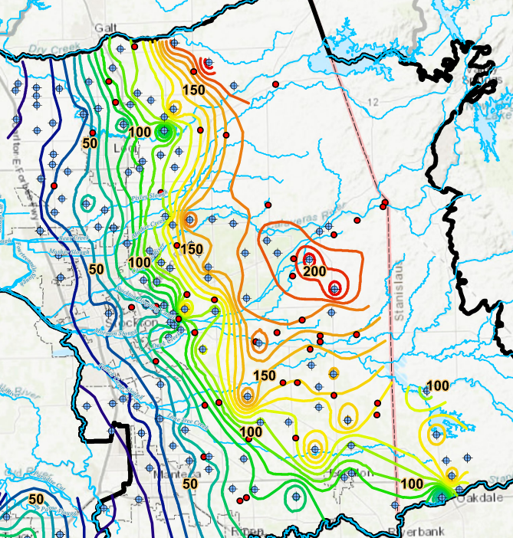
Fall 2025 Depth to Groundwater
(feet)

Slide 10
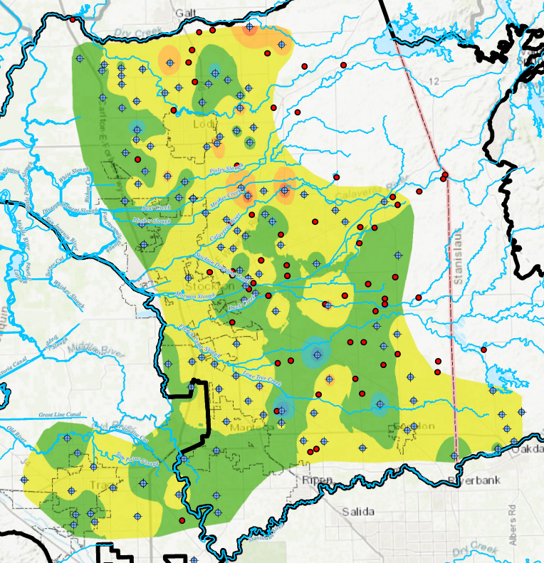
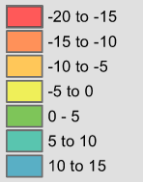
Groundwater Level Change
(feet)
Fall 2024 to
Fall 2025
Notes:
2024 was classified as an above normal (90% of normal precipitation) year, while 2025 was a below normal year (50-70% of normal precipitation) or over this two-year period, about average conditions and therefore would not expect significant changes in storage. As shown, most of the basin fluctuated between +5 to -5 feet.
There are still a few areas with greater changes.

Slide 11
Groundwater Level Comparison
Fall 2024 to Fall 2025
Number of Wells |  |  |  | Change in Elevation (feet)
GSA | Comparable | WSE Decrease | WSE Increase | Range | Average
CSJWCD | 10 | 6 | 4 | -6.5 to 13.5 | 1.1
NSJWCD | 18 | 11 | 6 | -13.5 to 9.5 | -2.1
OID | 1 | 1 | 0 | -4.5* | --
SEWD | 43 | 22 | 17 | -14 to 10.5 | -0.1
SSJID | 17 | 11 | 4 | -8 to 18.5 | 0.4
Tracy | 24 | 6 | 17 | -4.5 to 8 | 1.1
WID | 15 | 8 | 6 | -4 to 14 | 0.7
Stanislaus | 6 | 5 | 1 | -3.8 to 0.3 | -1.0
Total | 134 | 70 | 55 | -14 to 18.5 | 0.1
Notes:
The range in groundwater level changes shown in the table are excluding wells that had significant changes (greater than 40 feet) and is also due to the County performing a secondary round of groundwater level monitoring to resolve measurements that appeared to have been affected by pumping.

Slide 12
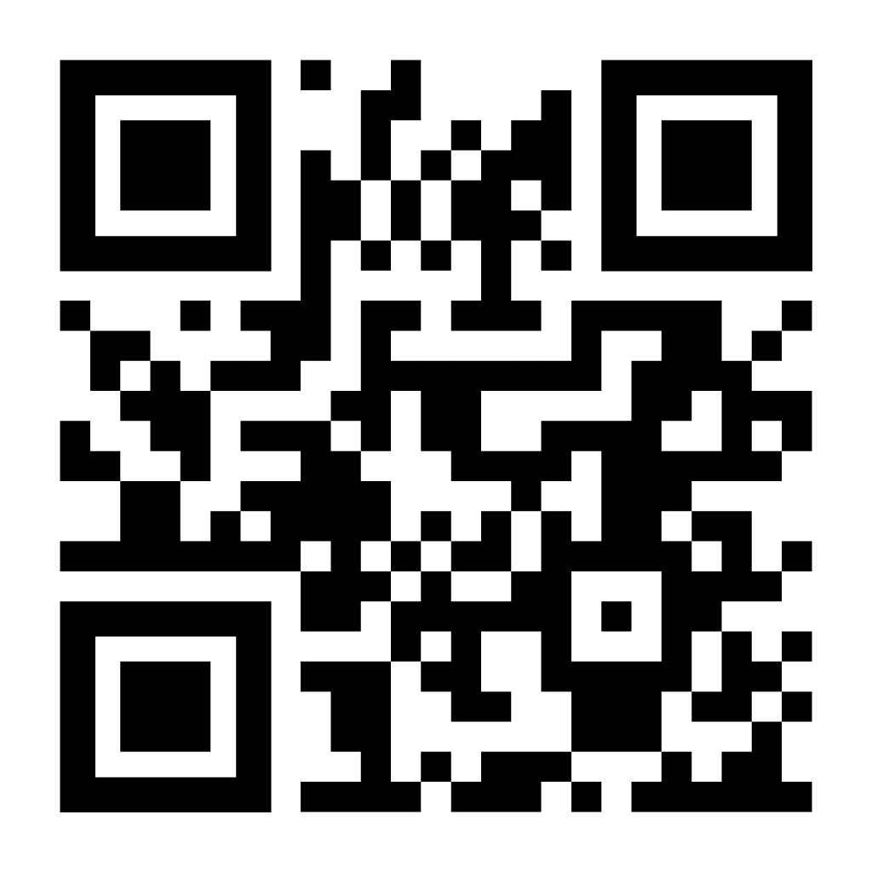
https://www.sjwater.org/Water-Resources-Management/Groundwater/Groundwater-Reports
San Joaquin County
Groundwater Report Web Page

Slide 13
Extra Slides

Slide 14
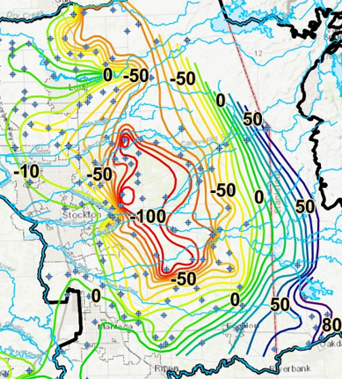
Fall 2024 Groundwater Elevations
(feet, MSL)
Notes:
All well locations are present, but many did not have measurements to show, affecting shape and extent of contours.
Note the pumping depression low on the west side.
Many wells were affected by pumping in Fall 2024 during the measurement period, the shape of the depression was affected.

Slide 15
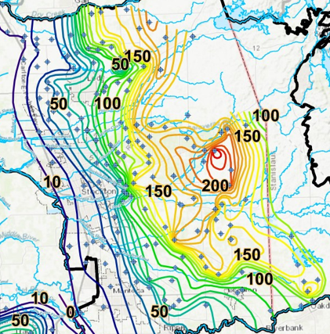
Fall 2024
Depth to Groundwater
(feet)

Slide 16
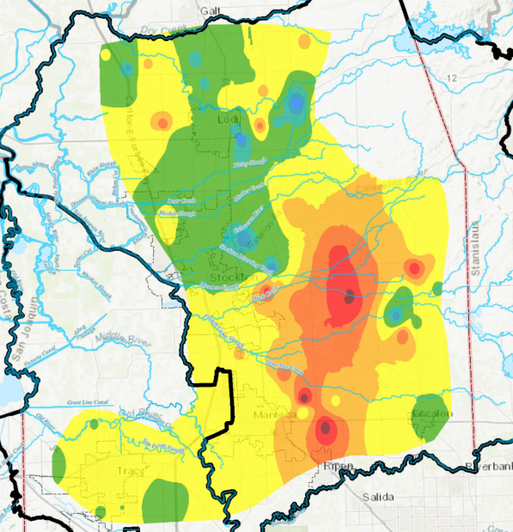
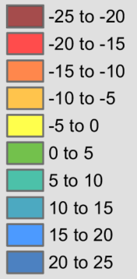

Groundwater Level Change
(feet)
Fall 2023 to
Fall 2024
Notes:
2023 was classified as a Wet year (130% of normal rainfall), while 2024 was normal (90% of normal rainfall) = Large drop in groundwater levels

Slide 17
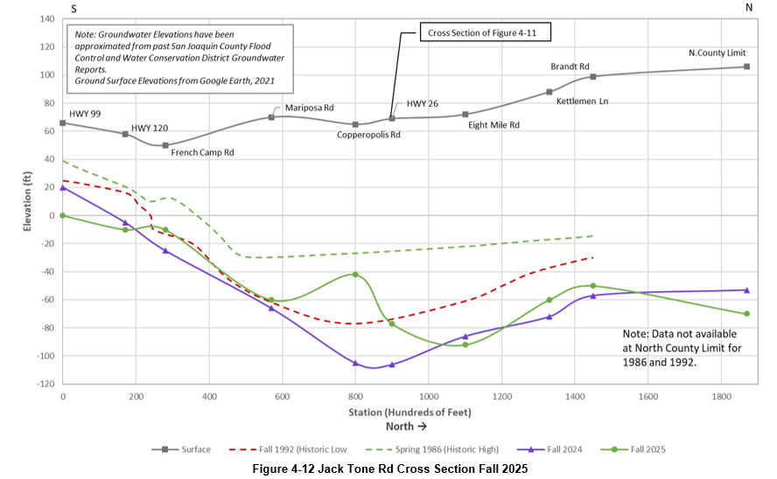
Monitoring Data and Data Gaps
These reports are susceptible to changes depending on the frequency and completeness of data gathered.
The County has gone through great lengths to make certain the data gathered is true and real, however some anomalous data points appear when subject to deeper analysis.
One Well in particular (01N07E01A002), introduced an anomalous data point compared to groundwater levels historically and changed the elevation profile for the Figure 4-12 cross section.
Notes:
Cross section shows increase of 60 feet
Only one well responsible. 01N07E01A002
Well was only measured once in Spring 2024 which showed groundwater levels being 15 feet deeper.
No comparable Fall data to show if anomaly or true

Slide 18
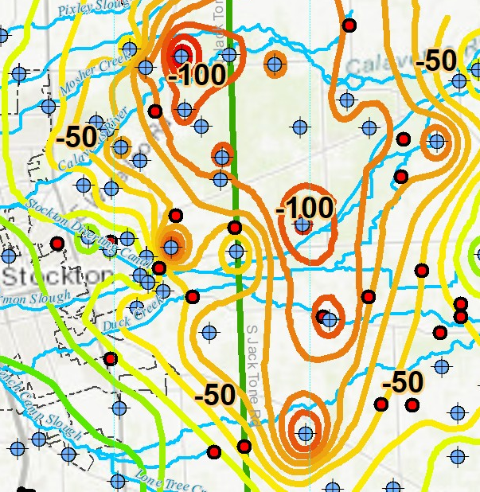
Monitoring Data and Data Gaps
This data point changed the groundwater level contour for the area near Copperopolis Road and shows that the groundwater level apparently increased by over 60 feet.
This change was not captured by our data comparison tables because the County was not able to gain access to the well since Spring 2024. In October 2025, a measurement was collected and included in the analyses.
Because of the area it was collected in, we could not discount whether it was an anomalous data point or true conditions, only consistent repeated measurements will show whether this area is part of the groundwater depression, or an isolated incident.
Notes:
Well is directly in line with cross section, drastic effect on shape of depression and groundwater level profile.
Only consistent repeat measurements can say if it’s a representative of groundwater conditions, or the well is disconnected.
If well is disconnected we will remove from monitoring network, but restriction of data used is not preferred.
True solution is to construct dedicated groundwater monitoring wells that County has ownership of and can always access to track groundwater levels.
Currently this well has no public construction details, and is privately owned, meaning future access is not guaranteed.

Slide 19
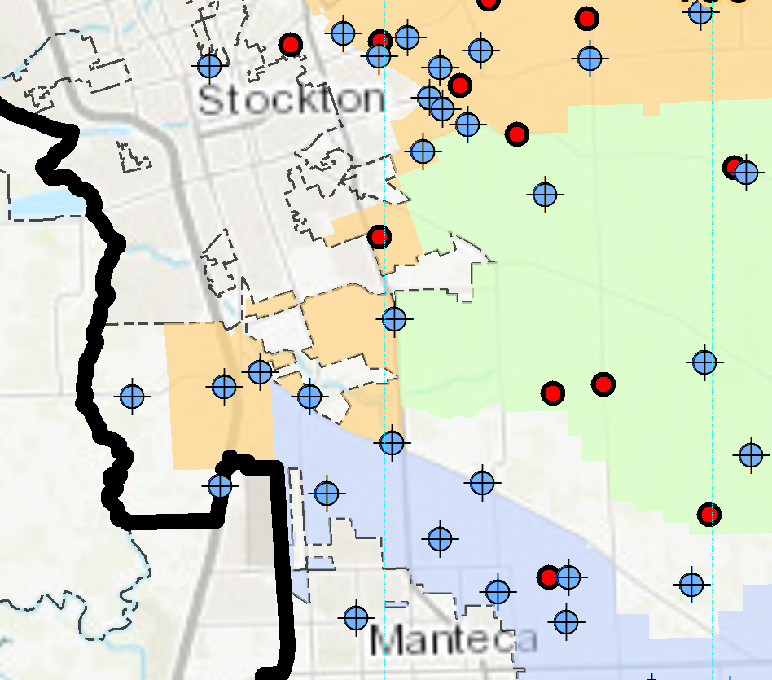
Monitoring Data and Data Gaps
Historically, these reports had a strict format of simply reporting collected data, when GEI began working on them for the County in 2020, the reports were recreated as close as possible to the originals.
Since then, improvements have been made to the structure and the scope was increased to include precipitation and river station data, as well as deeper analyses of the groundwater conditions.
Through lessons learned and the more focused concerns of the County and local Agencies, GEI has revised the reports beyond the original scope and partnered with the County; has increased the scrutiny of groundwater level data collected.
Not included in tables
Starting in the Spring 2026 report; a new table of comparable data will be added to the Appendix; 4-10.
This table will show comparison data for the wells not under the jurisdiction of local agencies.
Also, wells that have been added to the network since these reports began will be added to their corresponding data tables (4-1 through 4-9) for wells under the jurisdiction of their local Agency.
Notes:
Over 250 wells being monitored by the County staff
99% of these wells are privately owned
Owners are becoming increasingly paranoid about sharing water level data, or allowing strangers onto their property to collect the data
Leads to non-comparable data in tables, which can reduce level of certainty in contours
Refining data tables and scrutinizing the data is first step to narrowing the uncertainty.
Dedicated monitoring wells owned by county is permanent solution.

Slide 20
October 2025 Data Integrity Verification Exercise
(Comparison to Fall 2024 Groundwater Level Measurements)
Staff and our consultant measured groundwater levels at 5 production wells in 2025, each paired with a nearby monitoring well.
This effort was expanded to 19 wells, collecting remeasurements for Fall 2025 when the October measurement was distinctly higher/lower (20-50 foot change)
The remeasurement period was about two months later in December 2025 when a majority of agricultural pumping had ceased. The data was used in the report as the range of data collected fell within historic “normal” ranges.

Slide 21
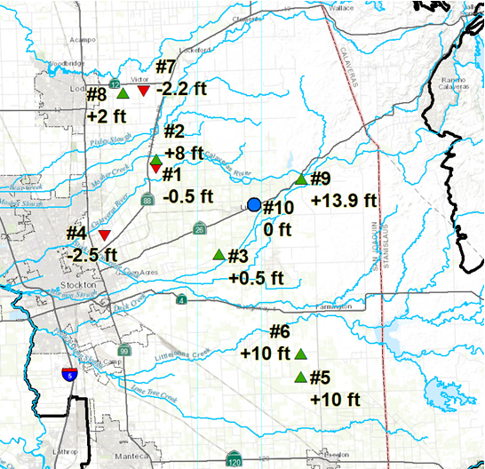
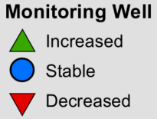
October 2025 Data Integrity Verification Exercise
(Comparison to Fall 2024 Groundwater Level Measurements)
Notes:
These 10 wells were selected for the supplemental monitoring because of the location and period of record.
Average decrease in groundwater levels by about twelve feet (-12 feet) between Spring 2024 and Spring 2025, and average decrease of almost 5 feet (-4.84 feet) between Fall 2023 and Fall 2024 in the ESJ subbasin.
Data for Fall 2025 is scheduled to be delivered on October 31.

Slide 22
October 2025 Data Integrity Verification Exercise
(Comparison to Fall 2024 Groundwater Level Measurements)
Well # | WSE Fall 2024 (feet) | WSE Fall 2025 (feet) | Change 24-25 (feet)
1 | -116.0 | -116.5 | -0.5
2 | -75.0 | -66.7 | +8.3
3 | -103.0 | -102.5 | +0.5
4 | -33.5 | -36.0 | -2.5
5 | -31.7 | -21.7 | +10.0
6 | -48.0 | -38.0 | +10.0
7 | -42.0 | -44.2 | -2.2
8 | -37.0 | -35.4 | +1.6
9 | -42.0 | -28.1 | +13.9
10 | -86.0 | -86.0 | 0.0
Average |  |  | +6.7
Conclusion:
These values fall within the natural expected range of variability; therefore, we have no reason to question the accuracy/validity of the data

Slide 23
December 2025 Data Integrity Verification Exercise
(Comparison to October Groundwater Level Measurements)
State Well ID | October WSE (ft msl) | December WSE (ft msl) | Corrected Difference
02N07E34R001 | -116 | -101 | 15
02N08E04C001 | -68.5 | -70.5 | -2
02N08E09G002 | -38 | -21 | 17
03N07E15C004 | -36.5 | -48 | -11.5
03N07E17D004 | -27.9 | -29.9 | -2
03N07E33G002 | -38 | -32 | 6
03N07E36J001 | -89.3 | -92.8 | -3.5
04N07E17N001 | -38.8 | -49.8 | -11
01N08E29M002 | -71 | -57 | 14
01N09E05J001 | -37 | -14.5 | 22.5
01N09E30C005 | -71.7 | -44.7 | 27
01N09E31J001 | -38.45 | -47.45 | -9
01S07E25E001 | -6 | -11 | -5
01S08E30C002 | -25.5 | -21.5 | 4
02N07E03D001 | -83 | -84 | -1
03N06E05N003 | -7.5 | -7.5 | 0
03S05E04H001 | NM | 47.2 | --
05N06E36R001 | -42.8 | -41.8 | 1
01S08E05A001 | -99.9 | -98.9 | 1
The values collected in October were affected by local pumping effects, so the County remeasured them once all groundwater pumping activities ended in the basin.
This remeasurement resulted in higher quality data to be used in the analyses, report, and this presentation.
Notes:
These wells were chosen to be remeasured in December due to difference from previous year’s water level measurement, the 2024 data was heavily affected by groundwater pumping and so to offset this potential inaccuracy, the wells were remeasured once pumping across the basin stopped for the season.
Some wells were found to have a much higher SWL once pumping ceased.
Other wells declined slightly possibly due to lingering groundwater pumping effects, or other factors, but all remeasured depths to water were within the normal range.
These remeasurements help assure that the data being collected is accurate and gives a greater understanding of how the basin reacts to groundwater pumping.

